Slide 1
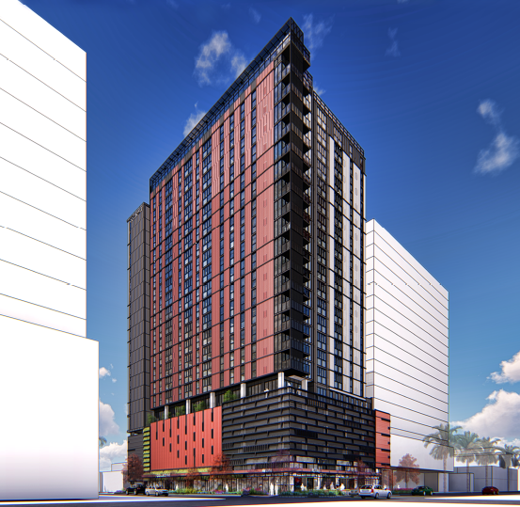
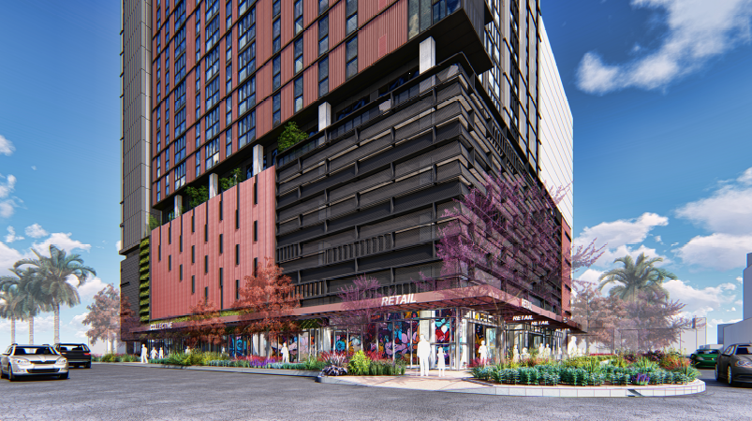
THE COLLECTIVE ON 7TH & MYRTLE
DEVELOPMENT REVIEW COMMISSION STUDY SESSION
FEBRUARY 13, 2018

Slide 2
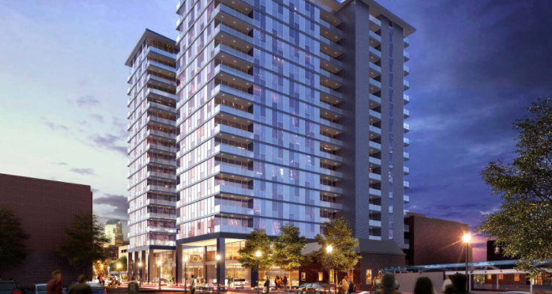
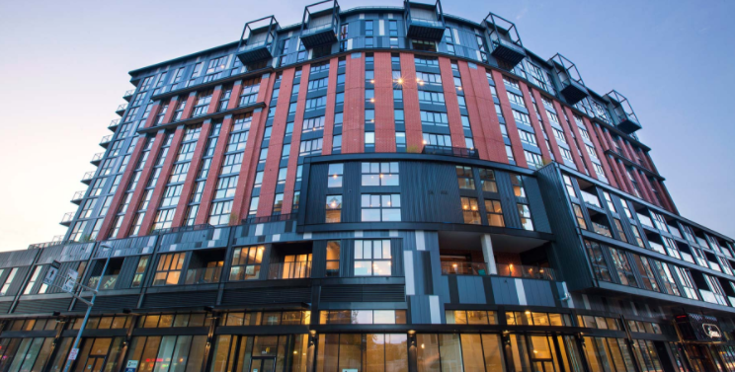
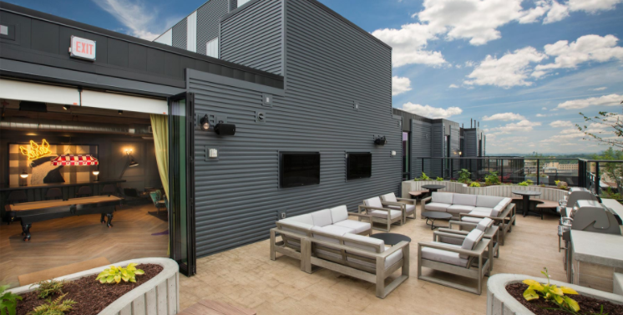
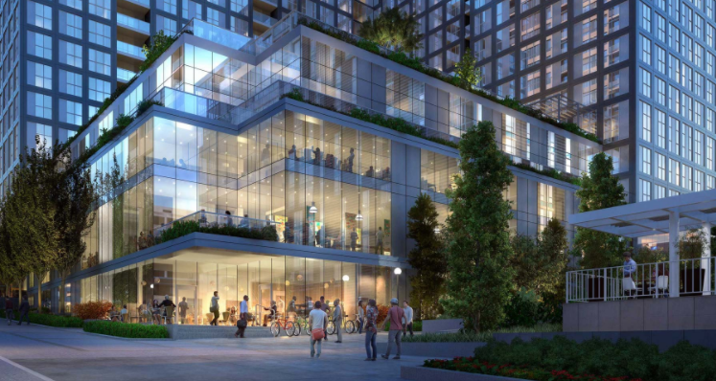
The Collective
Ann Arbor, Michigan
The James
Madison, Wisconsin
The Collective
Portland, Oregon

Slide 3
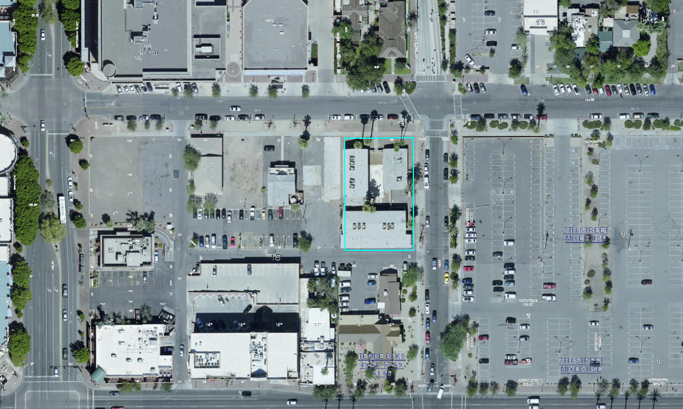
E. 7th Street
SITE LOCATION
S. Myrtle Avenue
S. Mill Avenue
W. University Drive
THE COLLECTIVE ON 7TH & MYRTLE PROJECT SITE

Slide 4
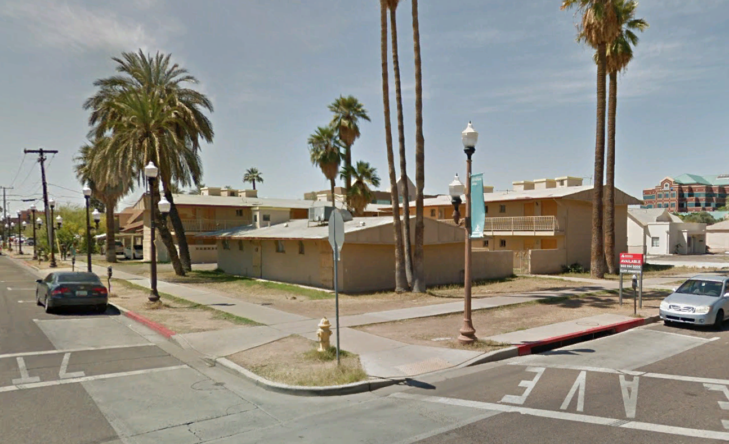
EXISTING SITE CONDITION
LOOKING SW FROM S. MYRTLE AVE. & E. 7TH STREET

Slide 5
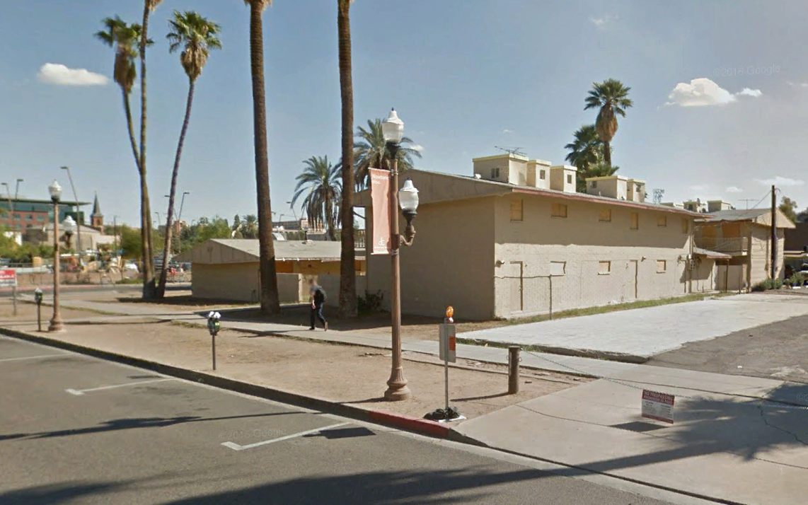
EXISTING SITE CONDITION
LOOKING SOUTHEAST FROM E. 7TH STREET

Slide 6
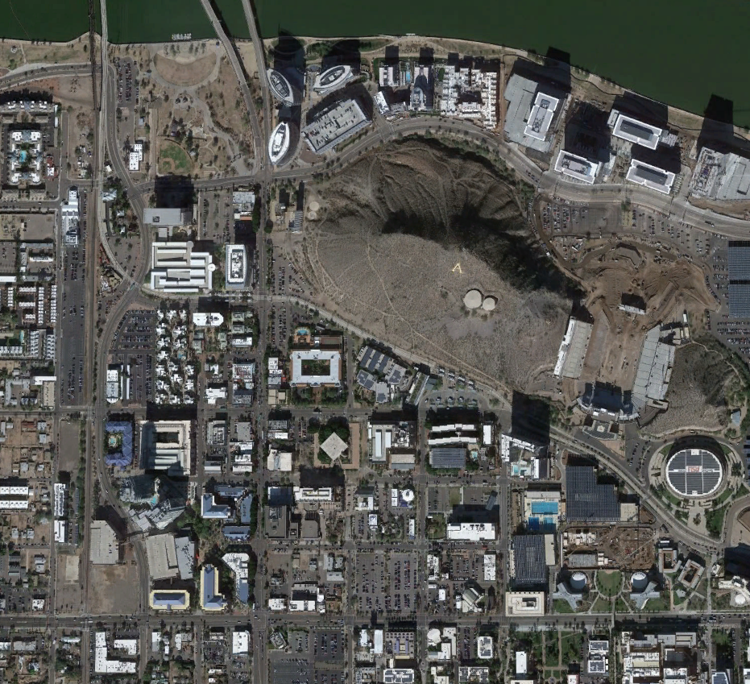
TEMPE TOWN LAKE
Hayden Ferry Phase III (10-stories)
Hayden Ferry Phase II (12-stories)
Hayden Ferry Phase I (8-stories)
Hayden Ferry Edgewater (8 stories)
Hayden Ferry Bridgeview (12 stories)
State Farm at Marina heights (253’)
ADP (144’)
Hayden Flour Mill (58’-161’)
Gateway Opus (132’)
Tempe Hayden Butte (333’)
Hayden Square (83’)
Light Rail Station at 3rd street and Mill Avenue
Hayden Square Condominiums (3-stories above podium garage)
Casa Loma Offices (48’)
Mission Palm Hotel (52’)
Tempe Transportation Center
The Hanover Project (85’)
Residence Inn (146’)
University House (195’)
West Sixth (258’-343’)
Brickyard (75’-96’)
College Ave Commons (5-stories)
Centerpoint Chase (81’-109’)
ASU Foundation Center (72’)
University Towers (8-stories)
7th Street Tempe Mixed-Use (Under const.- 20 stories)
7th & Forest (Approved - 235’)
All Saints Catholic Newman Center
House of Tricks (1-story)
Postino Annex & Snooze A.M. Eatery (1-story)
ASU Durham Language Building (6-stories)
ASU Global Institute of Sustainability (3-stories)
First United Methodist Church
ASU College of Design (4-stories)
Mirabella at ASU (20 stories – approved)
One Hundred Mill (15 stories)
The Foundry (Under const. -10 stories)
the Hayden (22 stories - proposed)
Westin Tempe (18 stories- approved)
2
3
4
TEMPE BEACH PARK
5
6
1
7
36
8
E. RIO SALADO PARKWAY
9
10
11
12
SURROUNDING USES
14
SUN DEVIL STADIUM
13
15
16
S. ASH AVENUE
17
E. 5TH STREET
S. MILL AVENUE
18
25
S. FOREST AVENUE
19
WELLS FARGO ARENA
38
E. 6TH STREET
20
30
21
29
22
E. 7TH STREET
S. COLLEGE AVENUE
39
27
37
23
26
28
24
S. MYRTLE AVENUE
E. UNIVERSITY DRIVE
35
34
33
32
31
The Collective on 7th & Myrtle Project Site

Slide 7
Amend Planned Area Development Overlay Zoning to establish site specific development standards
Approve Development Plan Review for project’s design, including site and landscape plans and building elevations and materials
Approve Use Permit to allow tandem parking (19 tandem stalls accommodating 38 resident spaces and one tandem stall accommodating 5 car share spaces for resident use)
REQUESTS

Slide 8
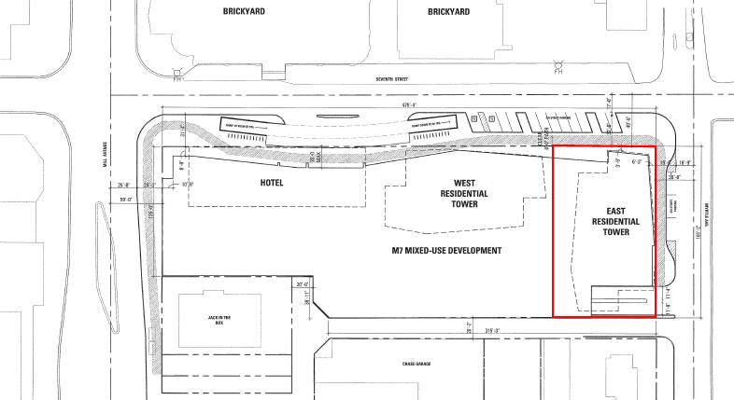
PAD overlay approved in 2008 to accommodate development up to 306 feet in height, including a 26-story residential tower on the project site
Current PAD allows up to 370 residential units
Development proposal represents a bldg. height reduction of +/- 66 feet
Development proposal represents a reduction of 101 residential units
2008 PAD OVERLAY ZONING
2008 M7 Mixed-Use Development Plan
The Collective on
7th & Myrtle Project Site

Slide 9
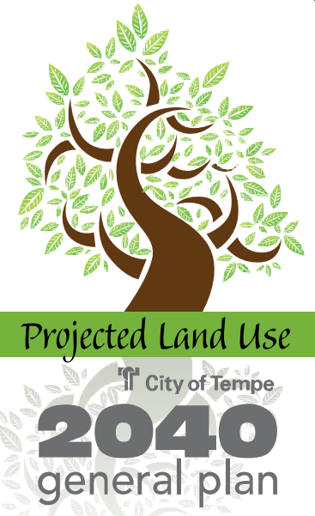
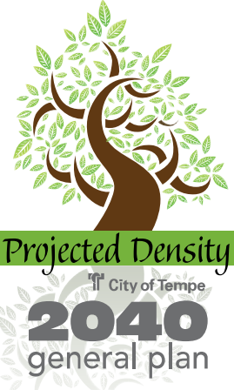
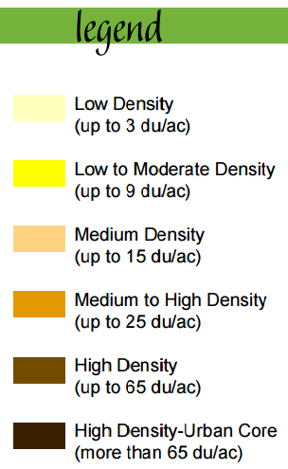
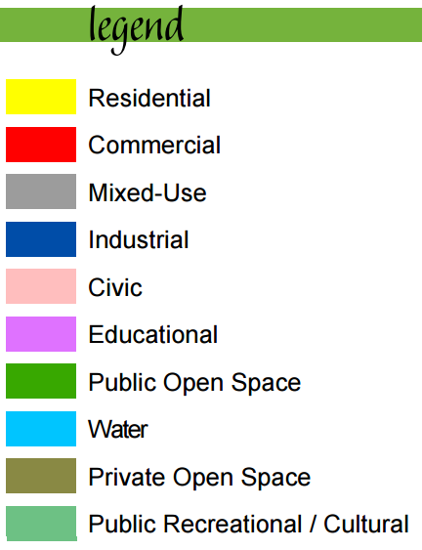
PROJECTED LAND USE
PROJECTED DENSITY
GENERAL PLAN 2040
The Collective on 7th & Myrtle Project Site
The Collective on 7th & Myrtle Project Site

Slide 10
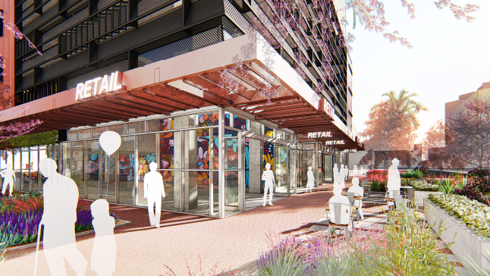
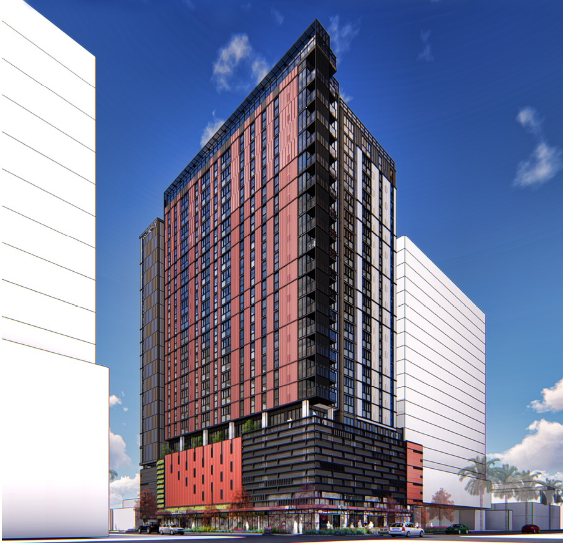
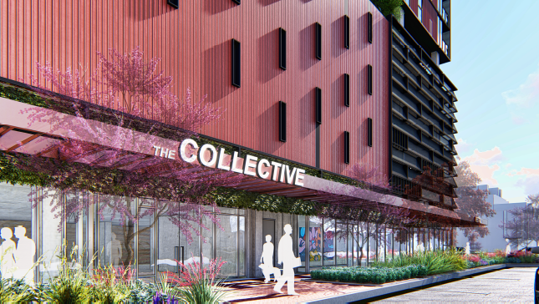
Twenty-two story (+/- 240 feet) mixed-use tower comprised of:
269 luxury market-rate rental residences
(18 micros, 54 studios, 34 one-bedrooms, 131 two-bedrooms & 32 three bedrooms)
+/- 6,000 sq. feet of retail/restaurant space on first floor
+/- 3,300 sq. feet of residential lobby and leasing office on first floor
+/- 4,470 sq. feet of indoor residential amenity space and communal garden on fifth floor
Five levels of structured parking providing:
160 vehicle parking spaces
29 moped parking stalls
336 bike spaces
Outdoor seating area near corner of E. 7th Street and S. Myrtle Avenue
Rooftop pool terrace
Retention of 9 on-street parking spaces along E. 7th Street and S. Myrtle Avenue
PROJECT OVERVIEW

Slide 11
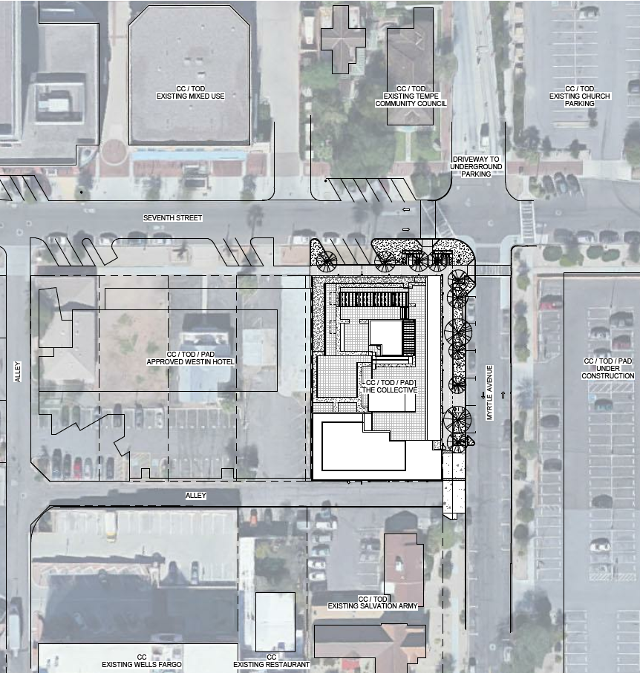
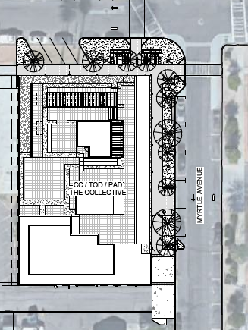
SITE / LANDSCAPE PLAN

Slide 12
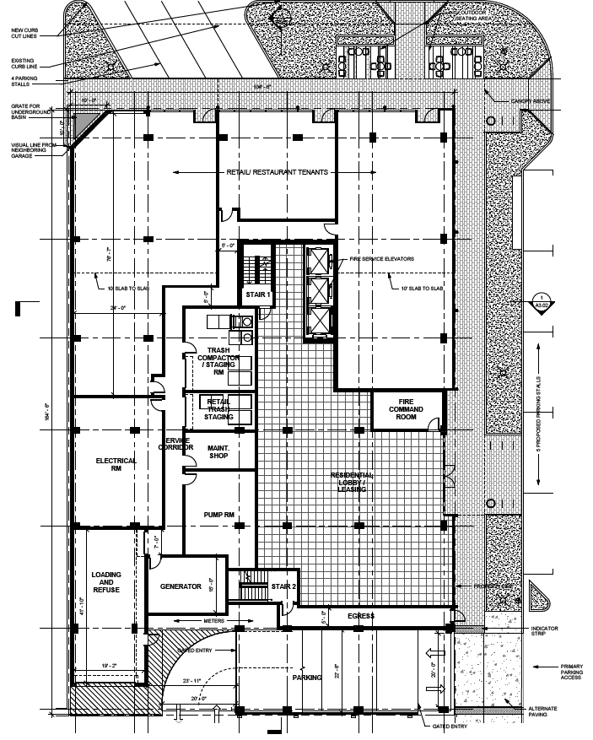
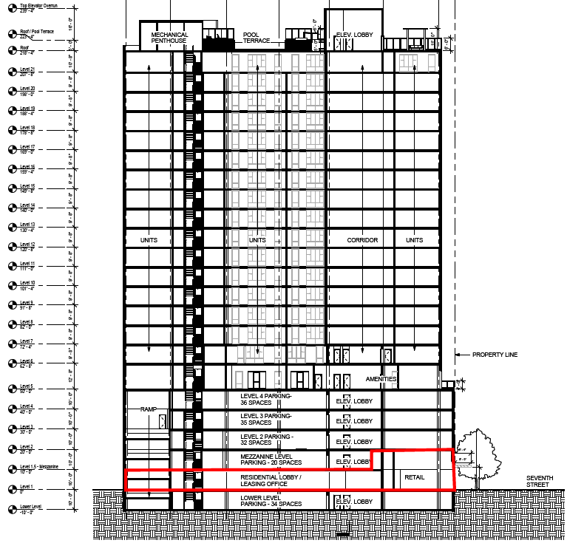
E. 7TH STREET
GROUND FLOOR PLAN
S. Myrtle Avenue

Slide 13
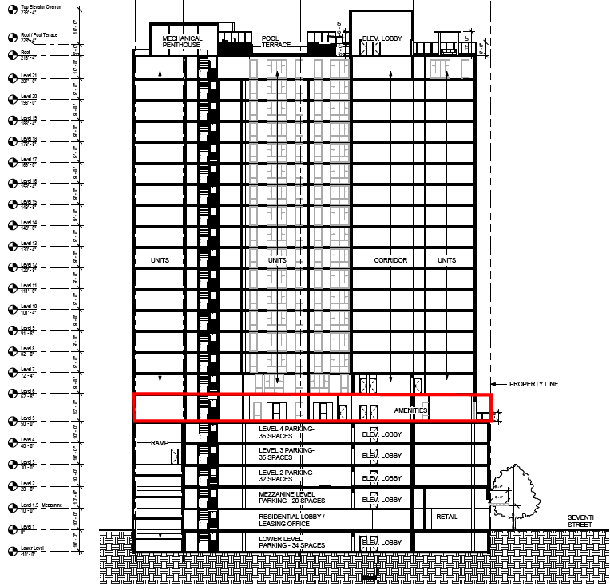
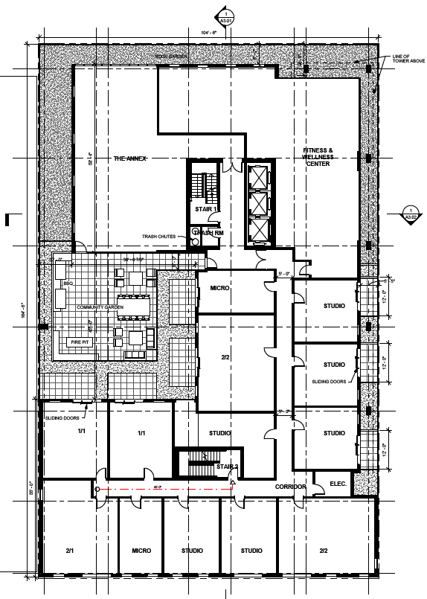
E. 7TH STREET
5TH FLOOR PLAN
S. Myrtle Avenue

Slide 14
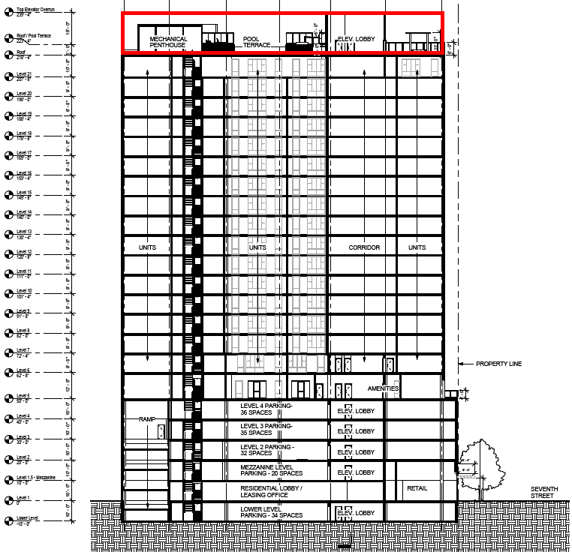
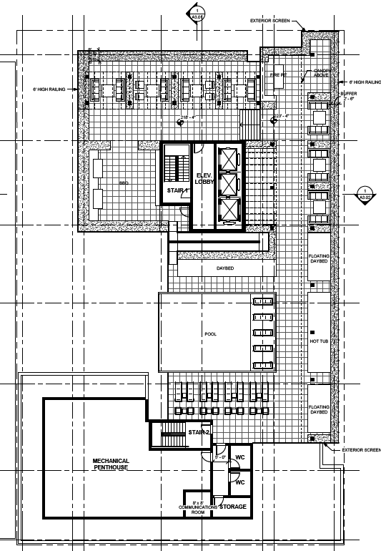
E. 7TH STREET
ROOF / POOL TERRACE PLAN
S. Myrtle Avenue

Slide 15
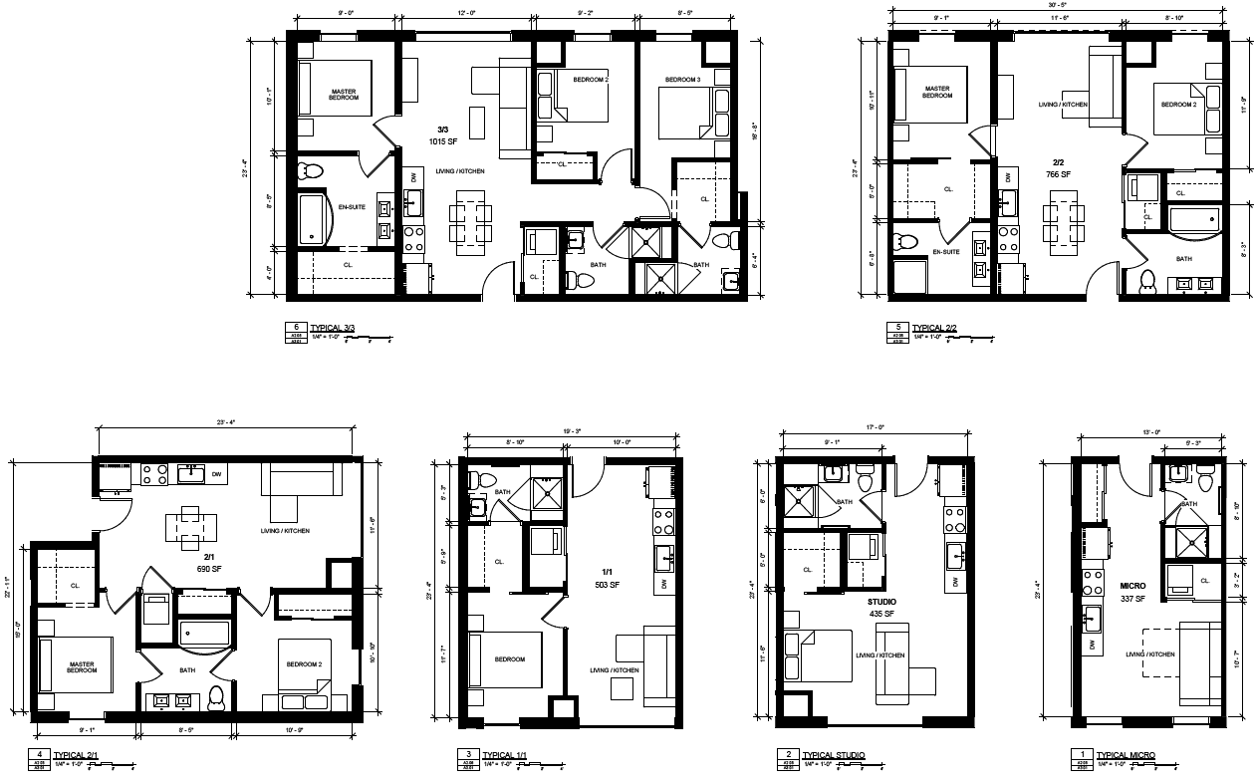
TYPICAL RESIDENTIAL UNITS

Slide 16
RENDERING
LOOKING SOUTHWEST FROM E. 7TH ST. & S. MRYTLE AVENUE
E. 7TH STREET
S. MYRTLE AVE.

Slide 17
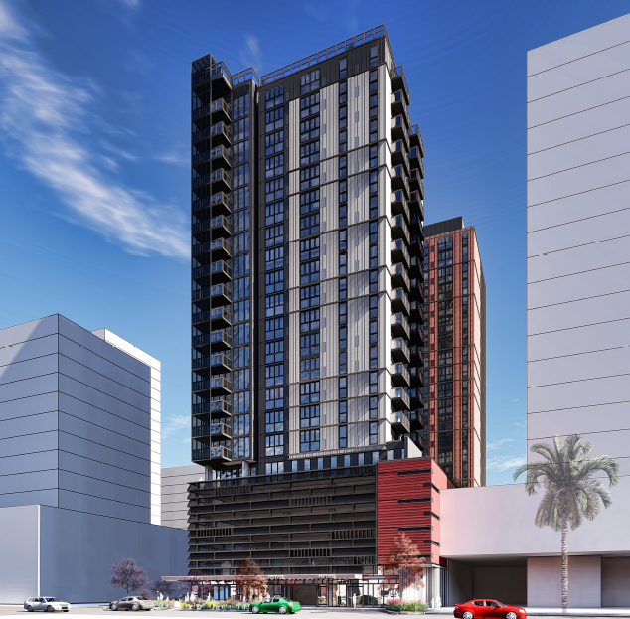
RENDERING
E. 7TH STREET
LOOKING SOUTHEAST FROM E. 7TH STREET
S. MYRTLE AVE.

Slide 18
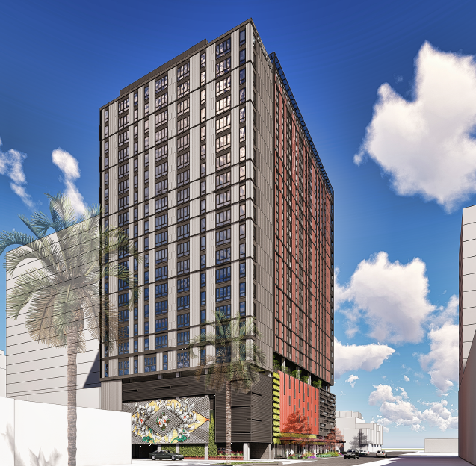
RENDERING
E. 7TH STREET
LOOKING NORTHWEST FROM S. MRYTLE AVENUE
S. MYRTLE AVE.

Slide 19
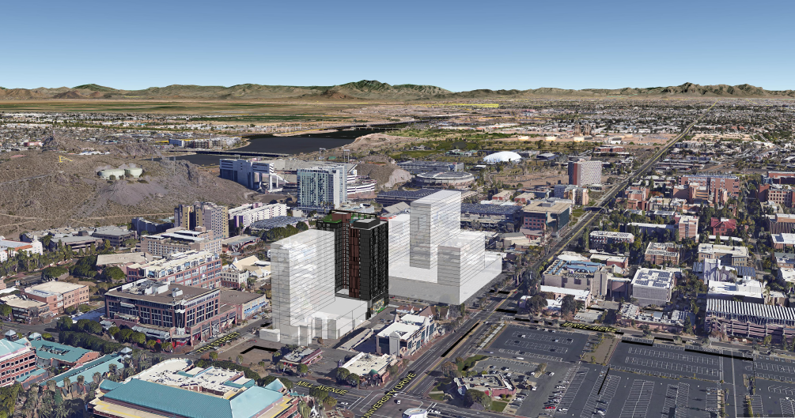
AERIAL 3D MODEL VIEW
LOOKING NE FROM S. MILL AVE. & E. UNIVERSITY DR.

Slide 20
E. 7TH STREET
S. MYRTLE AVE.
STREET LEVEL RENDERING
LOOKING SE FROM E. 7TH STREET & S. MYRTLE AVE.

Slide 21
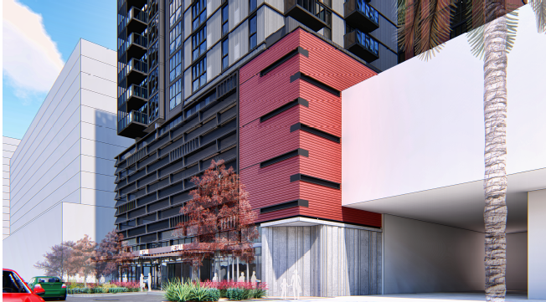
E. 7TH STREET
S. MYRTLE AVE.
STREET LEVEL RENDERING
LOOKING SOUTHEAST FROM E. 7TH STREET

Slide 22
E. 7TH STREET
S. MYRTLE AVE.
STREET LEVEL RENDERING
LOOKING NORTHWEST FROM S. MYRTLE AVENUE

Slide 23
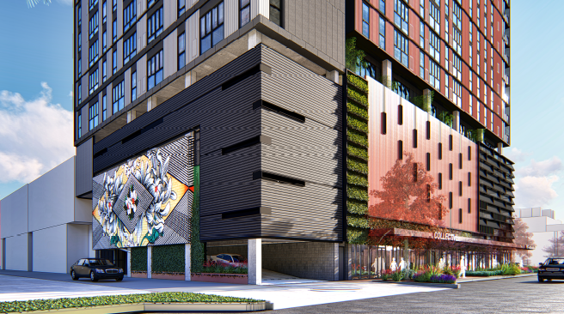
E. 7TH STREET
S. MYRTLE AVE.
STREET LEVEL RENDERING
LOOKING NORTHWEST FROM S. MYRTLE AVENUE

Slide 24
THE COLLECTIVE ON 7TH & MYRTLE
DEVELOPMENT REVIEW COMMISSION STUDY SESSION
FEBRUARY 13, 2018

