Slide 1
Millennium at Rio Salado
Development Review Commission
Study Session
April 10, 2018

Slide 2
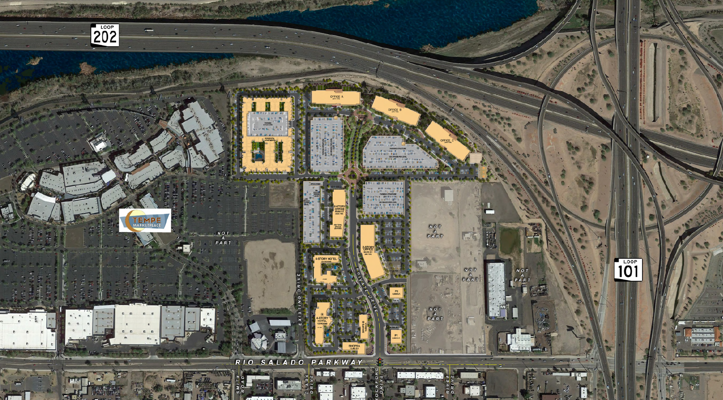

Slide 3
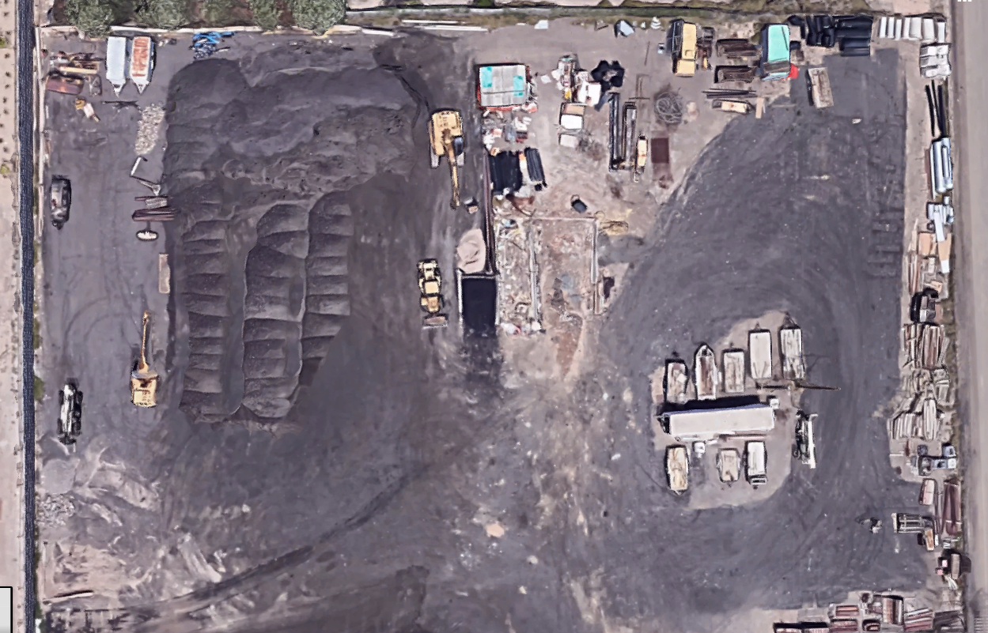
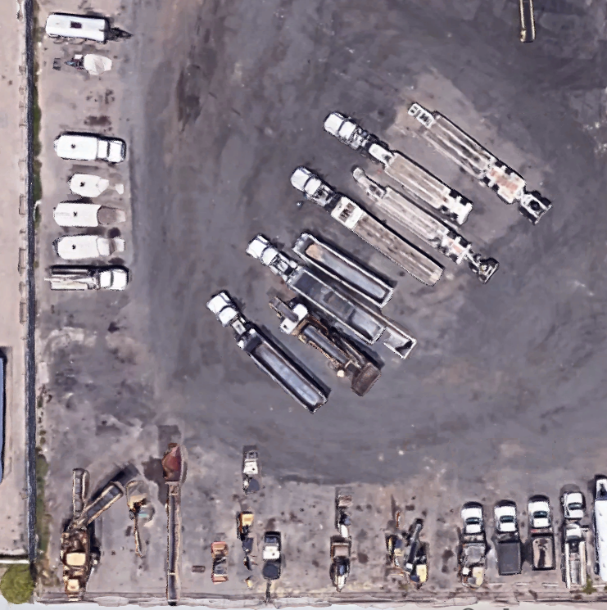
Existing Conditions

Slide 4
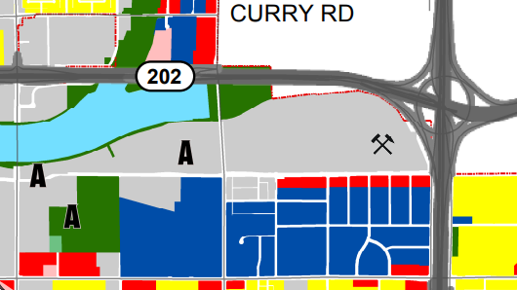

Slide 5
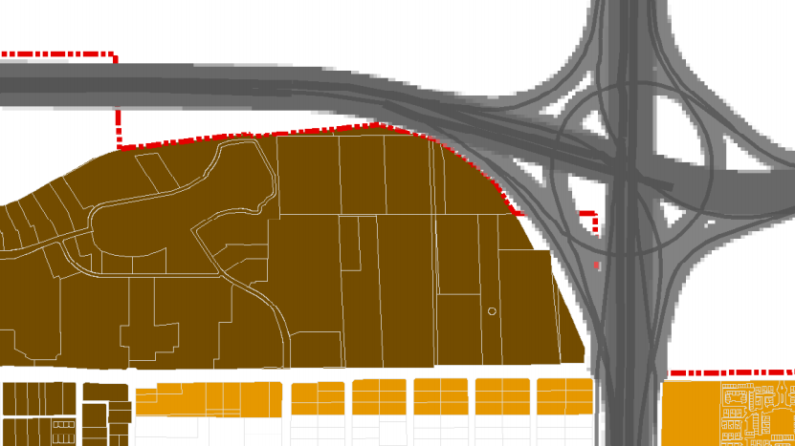

Slide 6
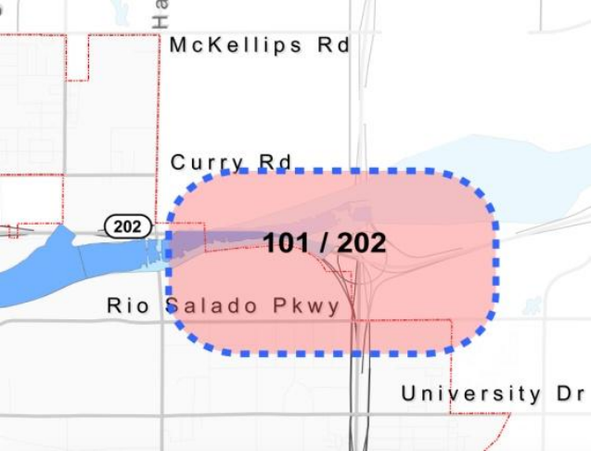
101/202 Interchange Growth Area
Goal 1: Remove blighted conditions and reclaim the area for reuse and redevelopment with mixed-use and regional business

Slide 7
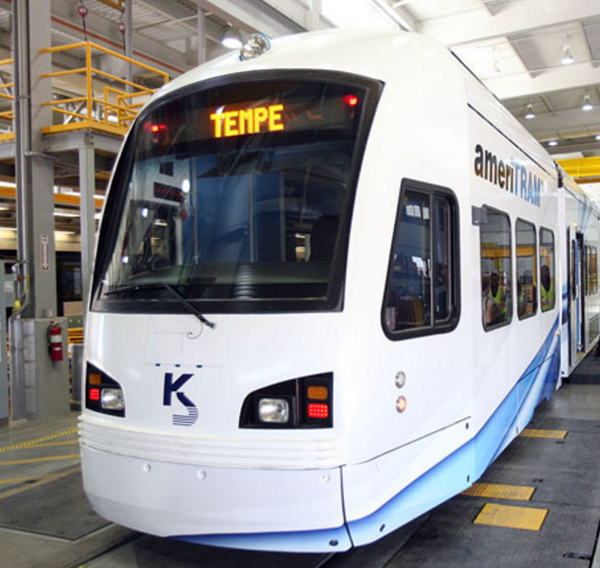
101/202 Interchange Hub
High pedestrian activity, resident focused services.
“Frontage improvement along Rio Salado is essential to redeveloping the area”
Multi-modal transportation center ideal for mixed-use commercial.

Slide 8
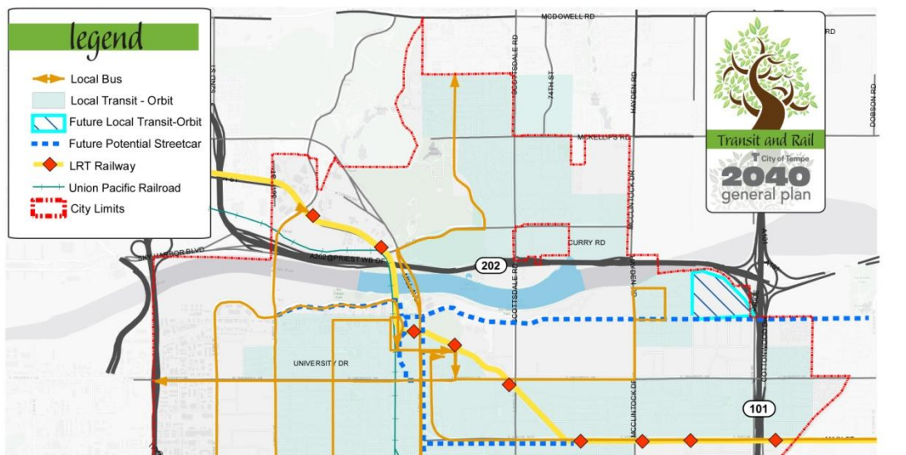
Future Streetcar Route
SITE

Slide 9
Request
Rezoning from HID to MU-4 PAD
260 Unit, 4-Story Apartments
Modern Food Court Style Restaurants
Use Permit for Tandem Parking (Multi-family)
Development Plan Review

Slide 10
Proposed PAD Standards
Standard | HID Standard | Proposed PAD
Height | 40 feet | 65 feet
General Plan Density | 65 du/acre | 34 du/acre
Street Side Setback | 25 feet | 25 feet
Side Setback | 0 feet | 46 feet
Rear Setback | 0 feet | 63 feet
Parking Required | 689 spaces | 668 spaces

Slide 11
Proposed PAD Standards
Standard | MU-4 Standard | Proposed PAD
Height | No standard | 65 feet
General Plan Density | 65 du/acre | 34 du/acre
Street Side Setback | No standard | 25 feet
Side Setback | No standard | 46 feet
Rear Setback | No standard | 63 feet
Parking Required | 689 spaces | 668 spaces

Slide 12
Parking Study
High availability of alternate modes of transportation
Future streetcar route
Bus (Valley Metro and Orbit)
Pedestrian/bicycle
Determined need for parking – 663 spaces (668 provided)

Slide 13
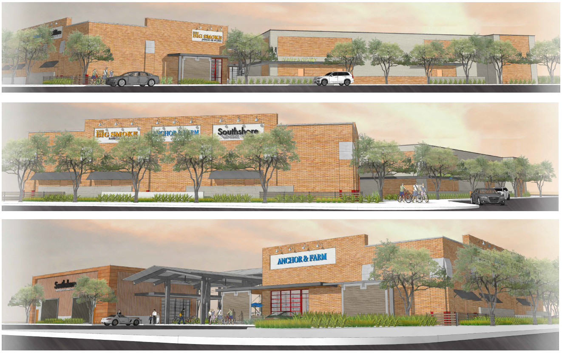

Slide 14
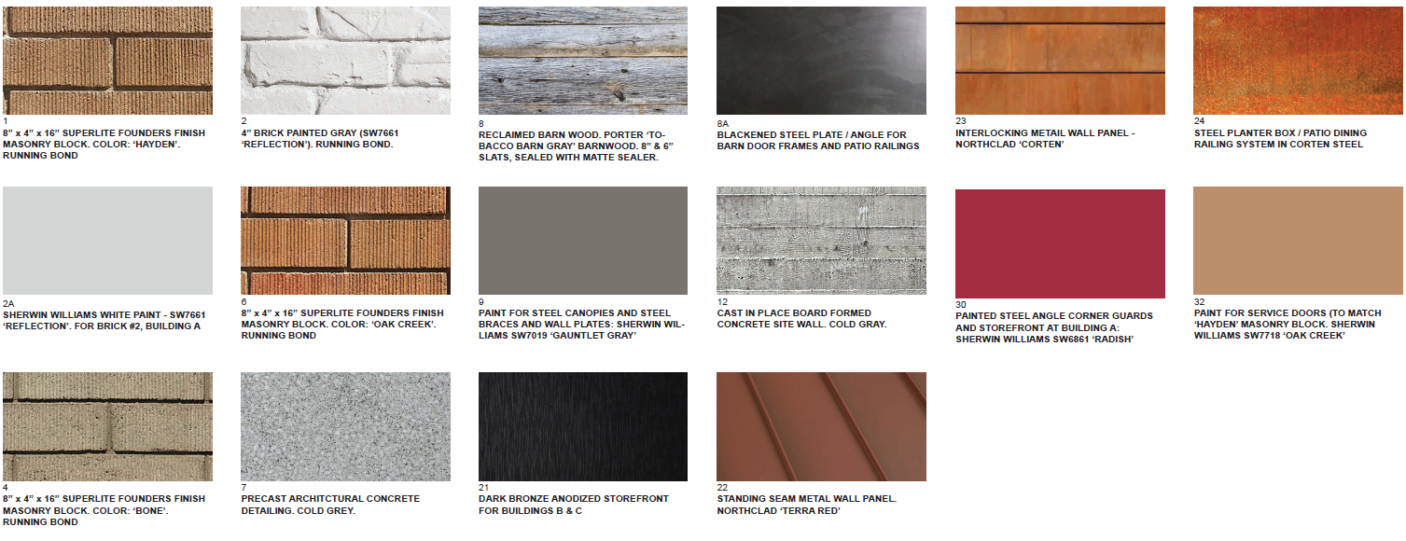
Food Hall Colors and Materials

Slide 15
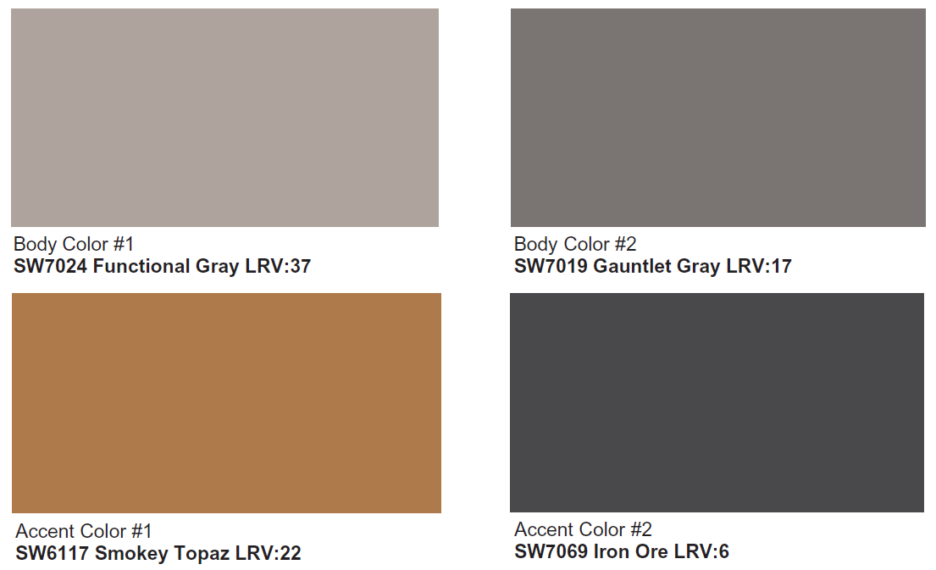
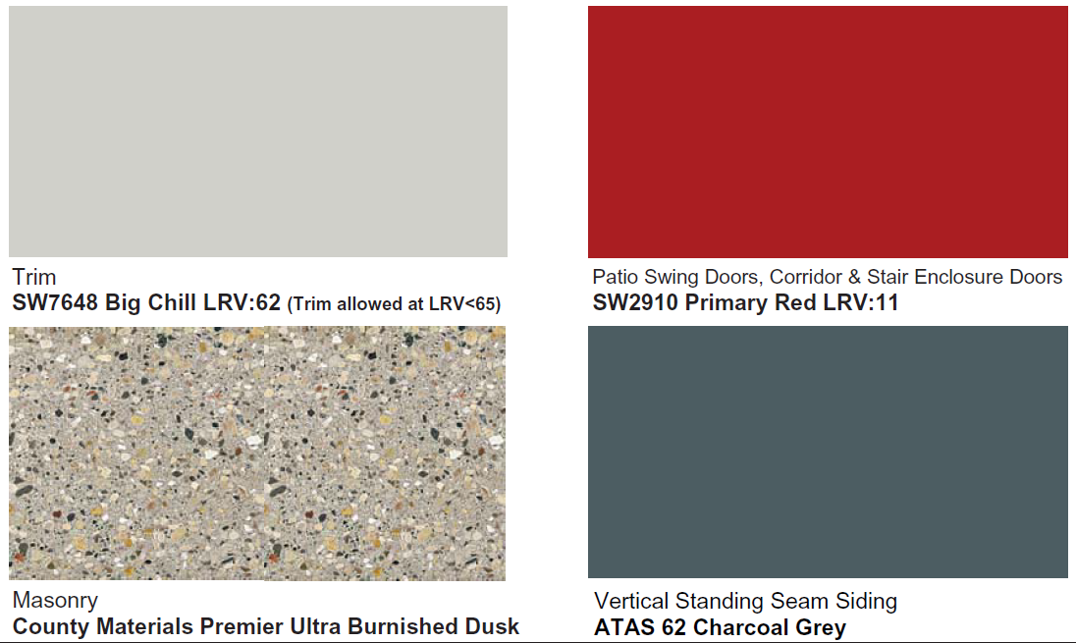
Residential Colors and Materials

Slide 16
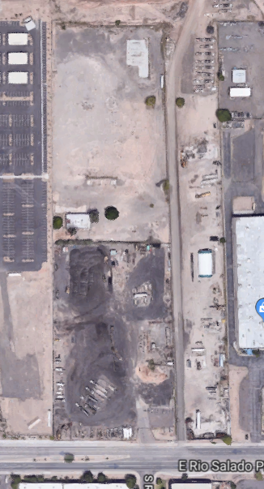
Site Plan
Food Hall along streetscape
Potential for vehicular connection to RIO 2100
Pedestrian connection between residential / food hall
Luxury multi-family residential
7,000 SF Clubhouse

Slide 17
Pedestrian Circulation Plan

Slide 18
Vehicular Connection

Slide 19
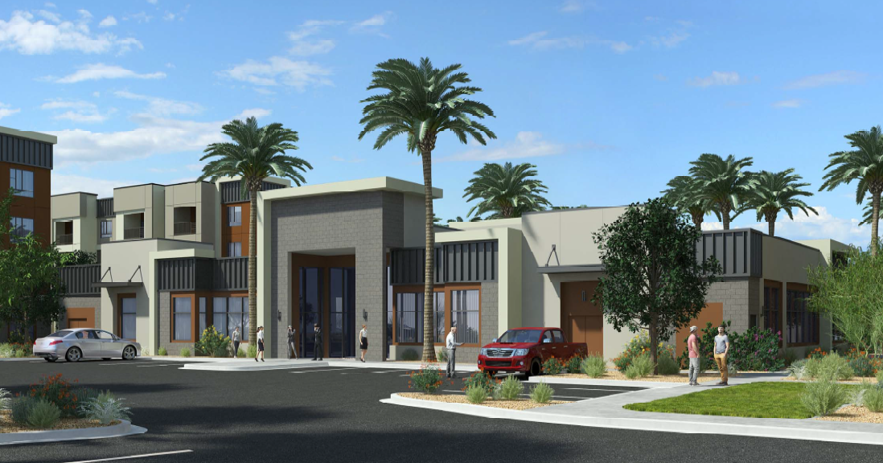
Clubhouse

Slide 20
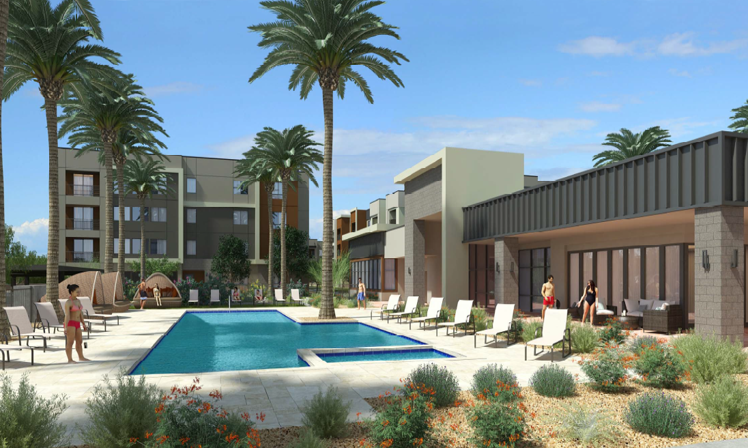
Clubhouse/Pool

Slide 21
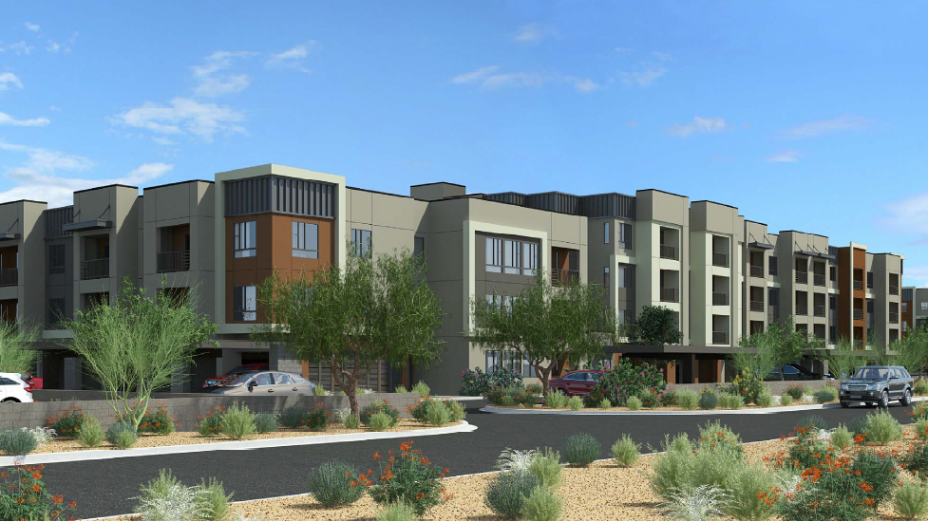
Multi-family

Slide 22
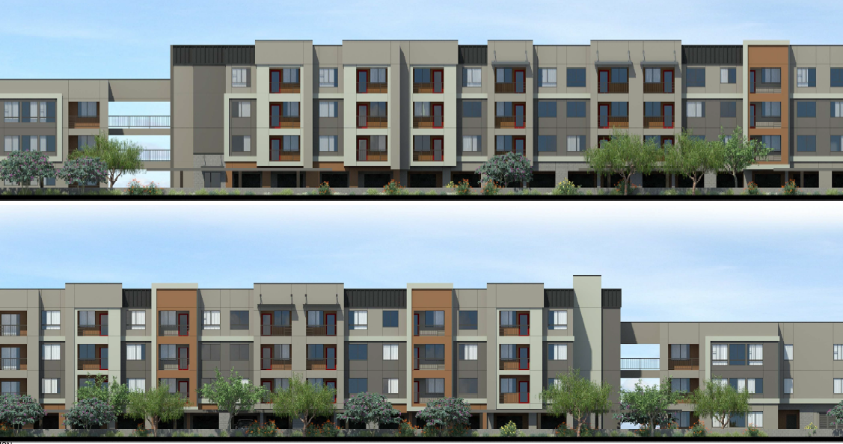

Slide 23
Thank you!

Slide 24
Use Permit Criteria
Use will not cause any significant vehicular or pedestrian traffic in adjacent areas.
Response: The garage tandem spaces are located on the interior garage section of the residential component and would not have any impact on traffic.

Slide 25
Use Permit Criteria
The use will not cause any nuisance arising from the emission of odor, dust, gas, noise, vibration, smoke, heat, or glare at any level exceeding that of ambient conditions.
Response: There would not be any nuisance of that kind generated by the tandem spaces. The number of vehicles would remain constant regardless of parking design.

Slide 26
Use Permit Criteria
The use will not contribute to the deterioration of the neighborhood or to the downgrading of property values, which is in conflict with the goals, objectives or policies of the City’s adopted plans or General Plan.
Response: Tandem parking is an asset to the development in that it allows ample parking without the negative visual effects of large parking areas.

Slide 27
Use Permit Criteria
The use will be compatible with existing surrounding structures and uses.
Response: Tandem spaces are compatible with the proposed residential use and will provide a viable parking option for residents that choose to utilize them.

Slide 28
Use Permit Criteria
The use will not result in any disruptive behavior which may create a nuisance to the surrounding area or general public.
Response: Disruptive behavior will not be created by tandem parking, which will be located within a gated development and not have any effect on the surrounding area.

Slide 29
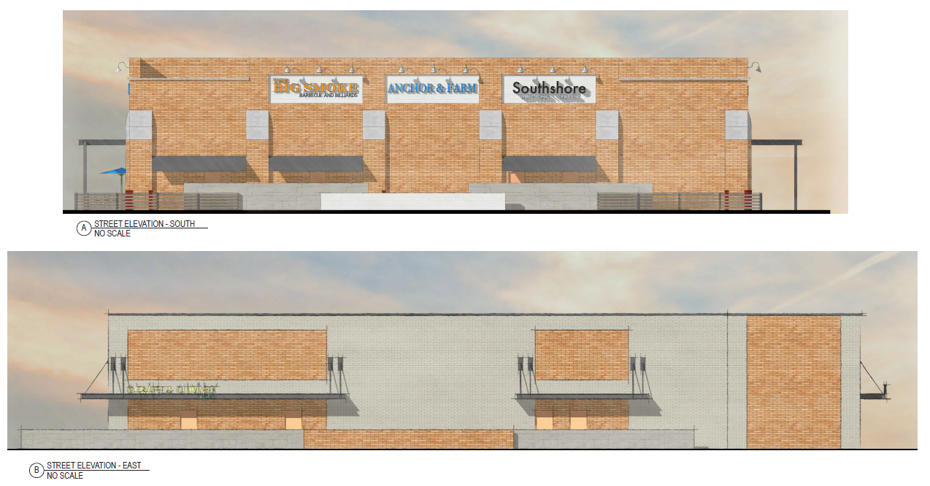

Slide 30
Compatibility with Rio2100 Retail Shops

