Slide 1
Tempe/Mesa Streetcar Feasibility Study
Winter 2020

Slide 2
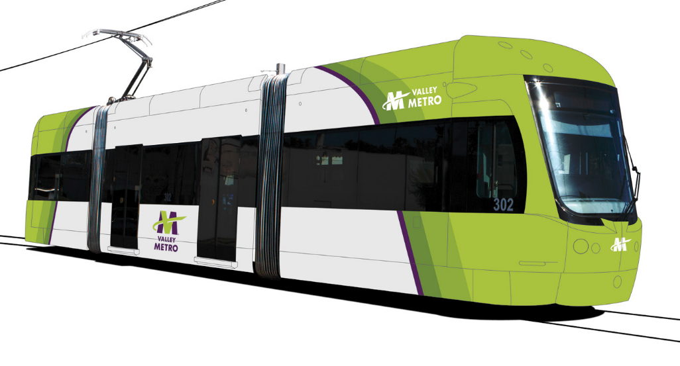
Agenda
Study Overview
Purpose
Study Area
Process and Timeline
Current Status
Related Projects

Slide 3
Overview
The cities of Tempe and Mesa have partnered with Valley Metro to evaluate streetcar as a high-capacity transit option
$600,000 budget co-funded by the cities of Tempe and Mesa
Notes:
Why are we doing this study:
Valley Metro is working with the cities of Tempe and Mesa to evaluate potential high-capacity transit options in Tempe and Mesa. The Tempe/Mesa Streetcar Feasibility Study will evaluate possible streetcar extensions to connect the Tempe Streetcar with key regional activity centers, employment destinations and emerging multi-unit residential developments in Tempe and Mesa. This study is an early, technical phase to determine feasible routes. Later phases will involve additional research and strong community involvement components.

Slide 4
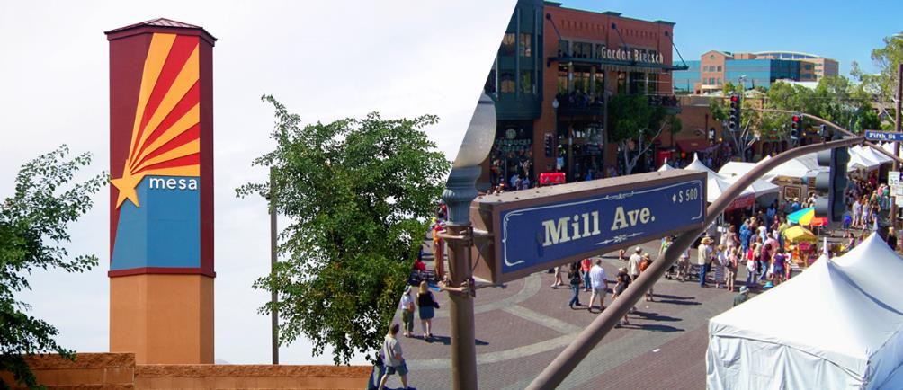
Purpose
Evaluate possible streetcar extension(s) to serve Tempe and Mesa
Link Tempe Streetcar with key regional activity centers, employment, residential
Evaluate feasibility of options
Identify potential next steps
Advise future regional
funding priorities
Notes:
What is the purpose:
Identify future streetcar system to serve the east valley communities of Mesa and Tempe as a means of providing high-capacity transit options
inform a future regional funding initiative for transit capital investments in both cities
identify steps to develop the transit components of a multimodal system.

Slide 5
Process
Identify Corridors
Identify corridors that meet project’s Purpose and Need and have high potential to improve transit
Tier 1 Evaluation
Qualitative, high-level analysis.
Tier 2 Evaluation
Quantitative, in-depth analysis
Recommend Corridors
Recommendation for future regional transit funding
City Council Recommendation
we are here
2018
2019
2020
Notes:
Covering multiple levels of technical analysis: from high level qualitative, to in-depth quantitative. Because this is evaluating technical feasibility, a stronger focus on public involvement will occur during potential future analysis.

Slide 6
Tier 1 Evaluation Results
Notes:
Evaluating major north/south and east/west corridors within the study area. Map shows preliminary results from Tier 1 analysis that was carried into the second phase of Tier 2 analysis.

Slide 7
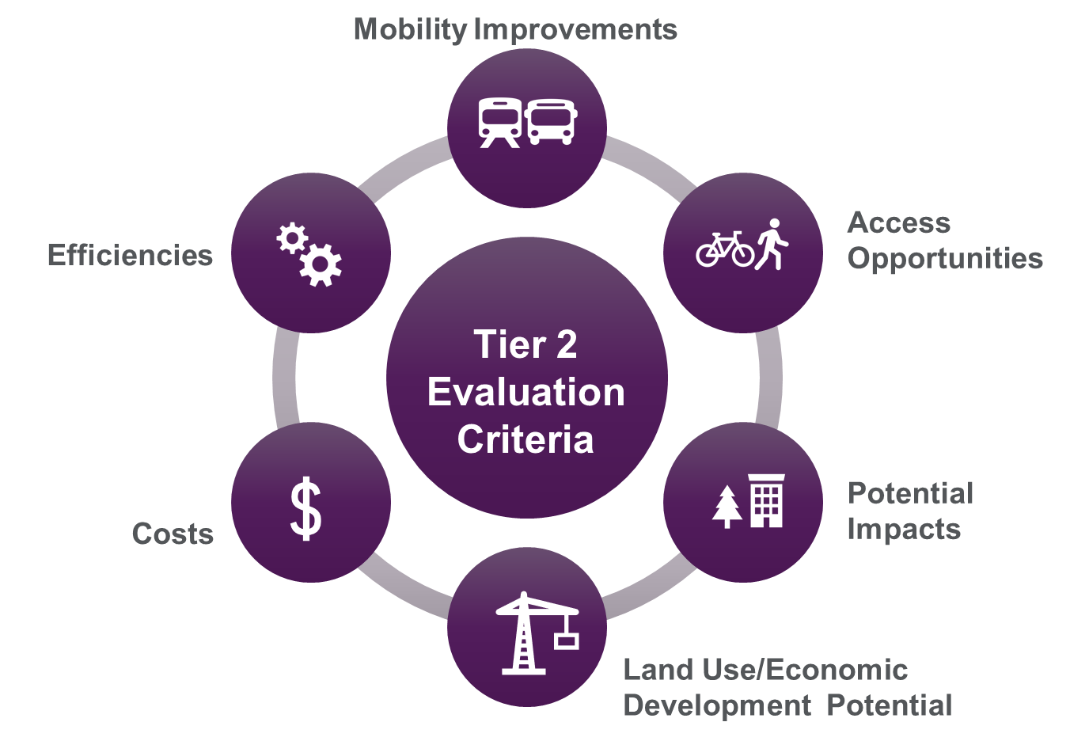
Tier 2 Evaluation Criteria
Notes:
Criteria
Mobility Improvements
Daily Transit Trips
Zero-car Transit Trips
Connectivity with Other Regional High-capacity Transit (HCT)
Ridership is determined by current transit ridership and potential future ridership
Access
Population in Study Area
Employment in Study Area
Publicly-supported Housing in Study Area
Connections with Other Transit Routes
Connections with Bikeways/Multi-use Paths
Impacts
Vehicular Traffic Capacity Impact
Right of Way
Historical and Cultural Resources
Section 4(f) Resources
Environmental Issues
Utilities
Land Use/Economic Development
Land Use Plan Consistency
Development Potential
Development Integration
Costs
Total Capital Cost
Operations and Maintenance Cost
Cost Effectiveness
Potential Opportunities for Financial Partnerships/Shared Costs
Efficiencies
Operating Efficiency
Transit Speed/Reliability
Scalability

Slide 8
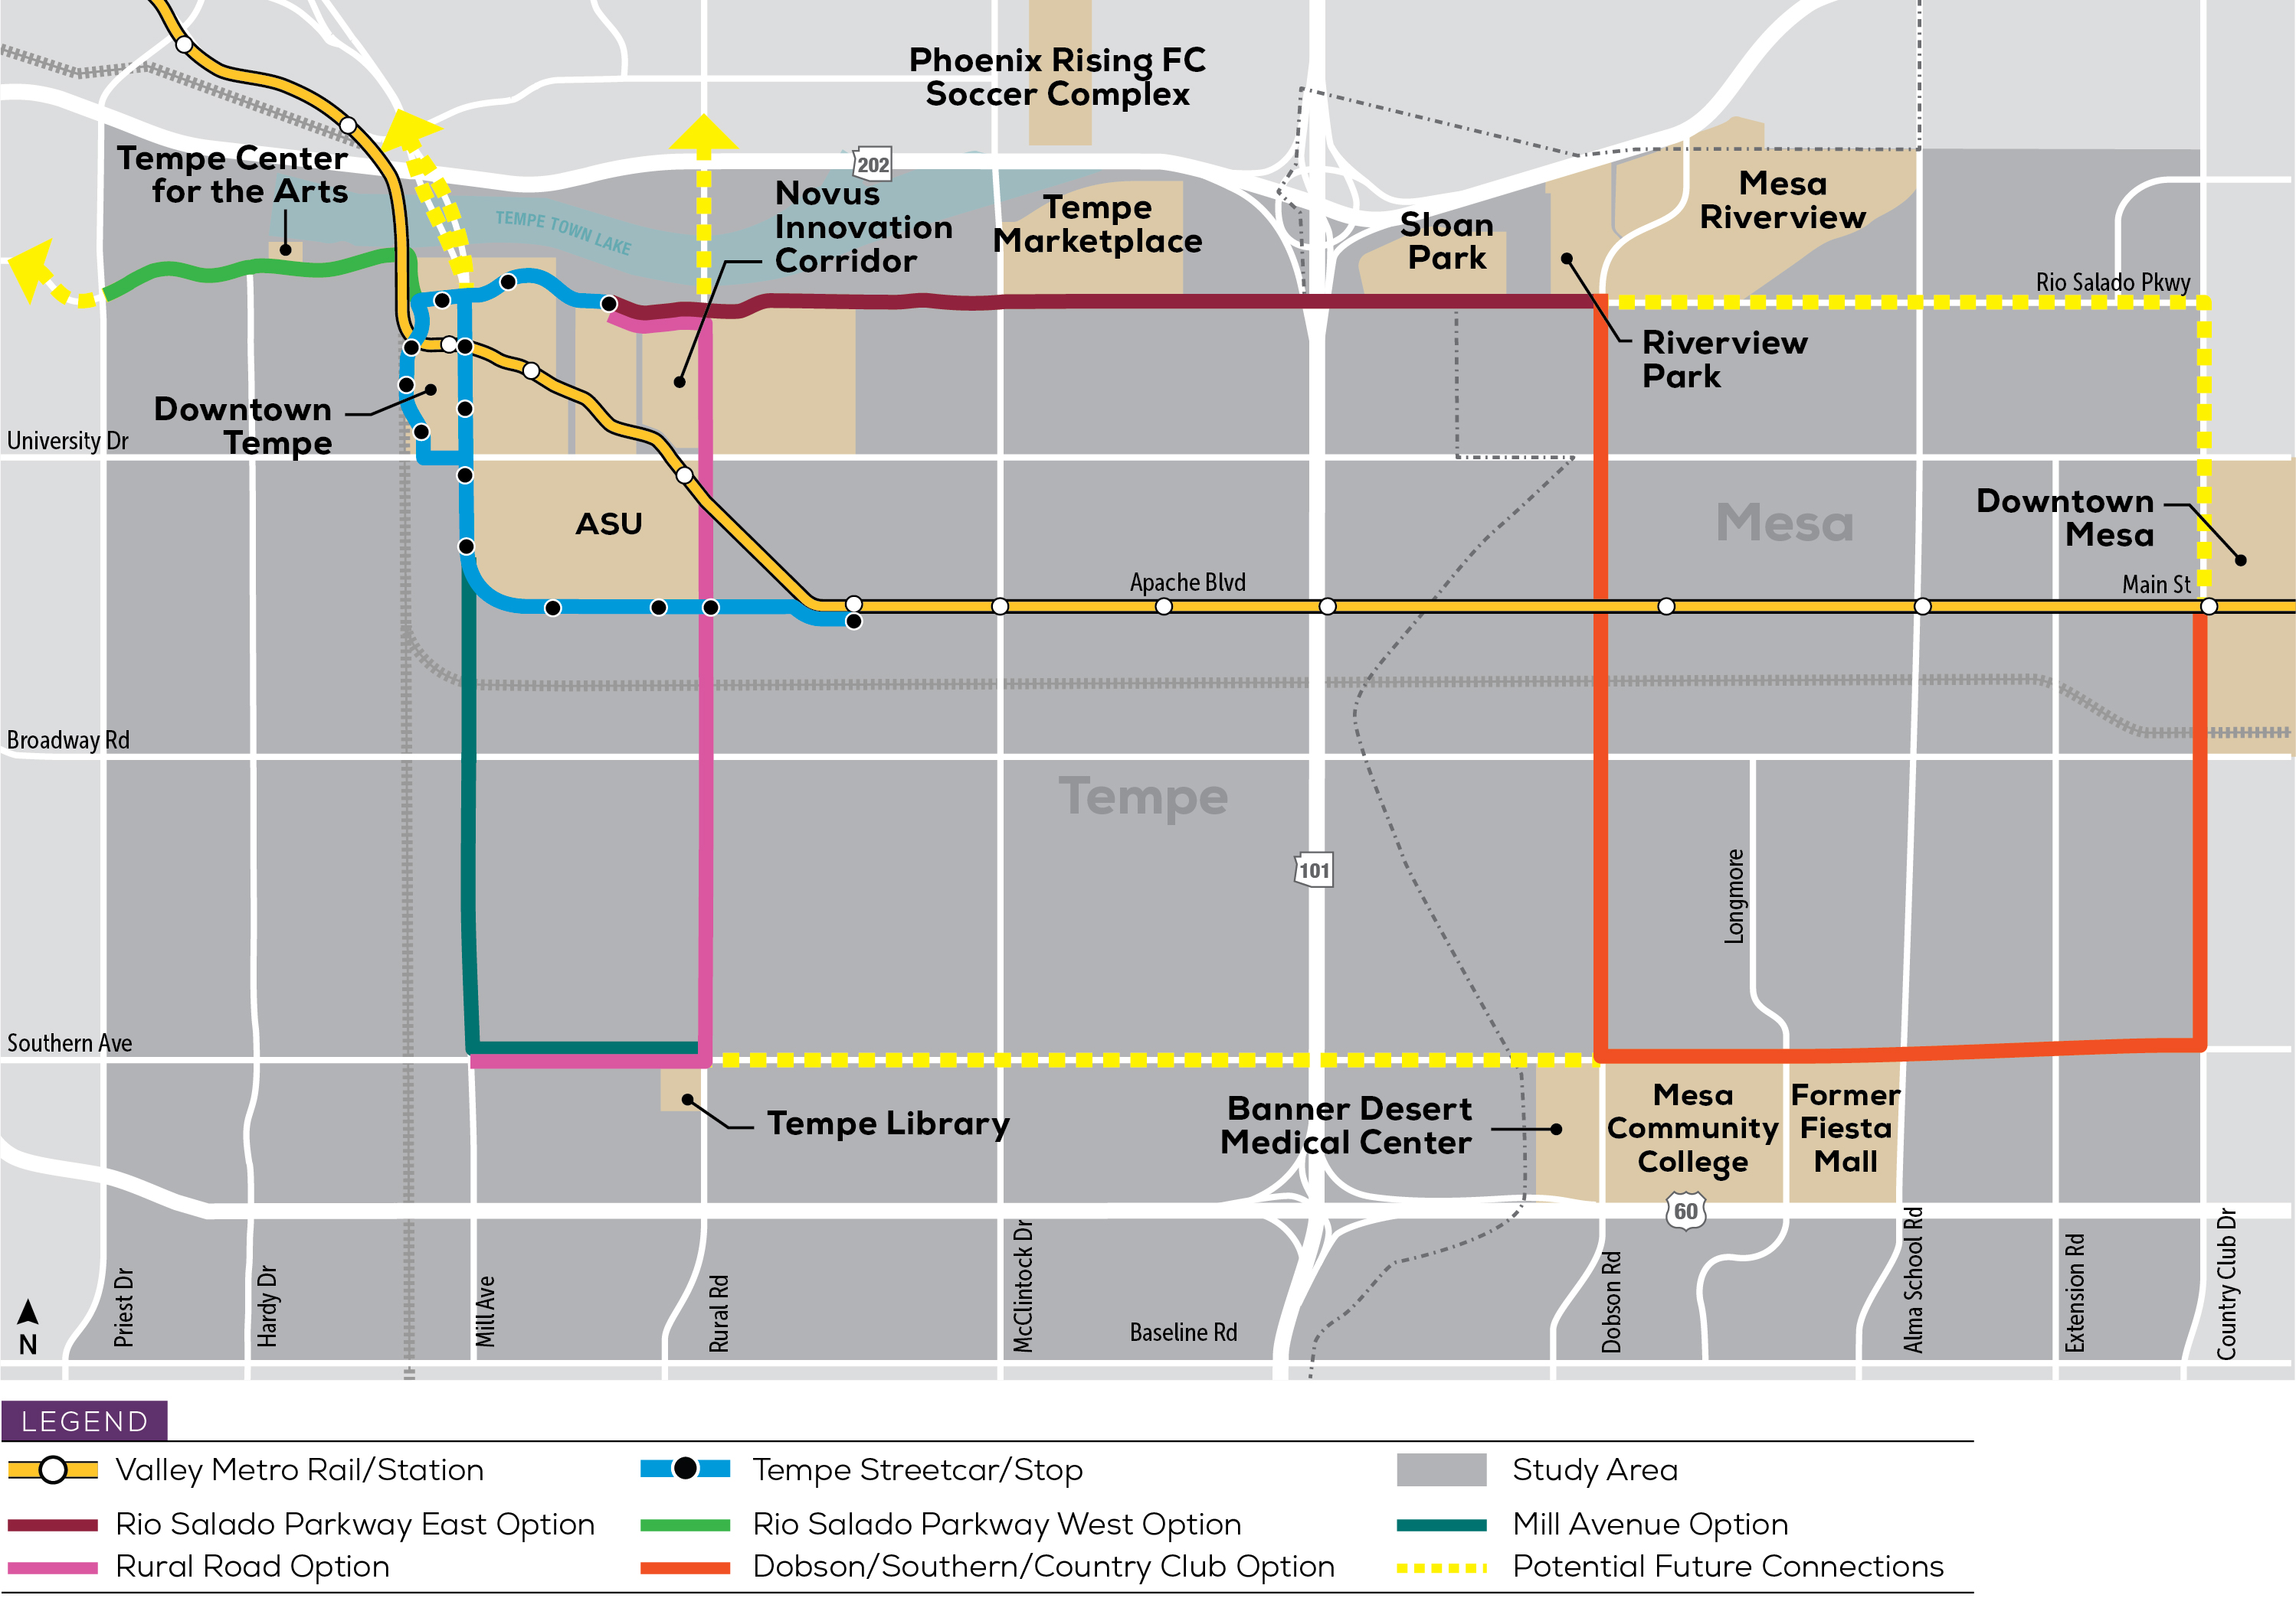
Tier 2 Evaluation Preliminary Results
1
Rio Salado East: Marina Heights to Dobson
Rural: Marina Heights to Southern/Mill
Dobson, Southern, Country Club
Mill: Apache to Southern/Rural
Rio Salado West: Ash to Priest
2
3
4
5
Notes:
Tier 1 criteria helped identify the most feasible corridors. Tier 2 criteria provided further quantitative, in-depth analysis that helped rank the feasibility of the 5 corridors identified in Tier 1.
Rio Salado East
Opportunities:
Minimal utilities/archaeological areas to mitigate
Heavy presence of multi-use, commercial, activity districts
Strong development potential and integration also possible in the future.
Low impact to automobile capacity: all car lanes preserved
Challenges:
Heavily trafficked corridor with multiple intersections that also hosts many events may affect reliability
Projected annual cost per rider may not be as effectual as other corridor options, low forecasted ridership
Rural
Opportunities:
Connectivity to other high-capacity transit options including LRT, TSC, and commuter rail
Population density and connectivity to other transit (local bus and circulators) is high
High forecasted ridership
Projected annual cost per rider more effectual than other corridor options
Challenges:
Low development potential or integration along corridor
Right of Way and Rail Road impacts
Dobson, Southern, Country Club
Opportunities:
High availability of affordable housing
High commercial and residential with activity centers and high potential for development and integration
Best corridor for scalability
Challenges:
Highest number of utilities to mitigate
Projected capital and O&M costs are higher than other corridors
Heavily trafficked corridor with multiple intersections
Mill
Opportunities:
Minimal ROW projected
Projected capital, O&M, annual cost per rider best rated of corridors
Challenges:
Low employment density
Reduced capacity for automobiles – most impactful of all corridors
Multiple historical resources along corridor
Low development and integration potential
Rio Salado West
Opportunities:
Minimal impact to automobile capacity
Potential future development along with existing connection to IDEA and TCA
Challenges:
Low forecasted ridership
Low population and minimal connectivity to other transit (local bus and circulators)
Requires ROW from Tempe Beach Park
Not designated transit corridor

Slide 9
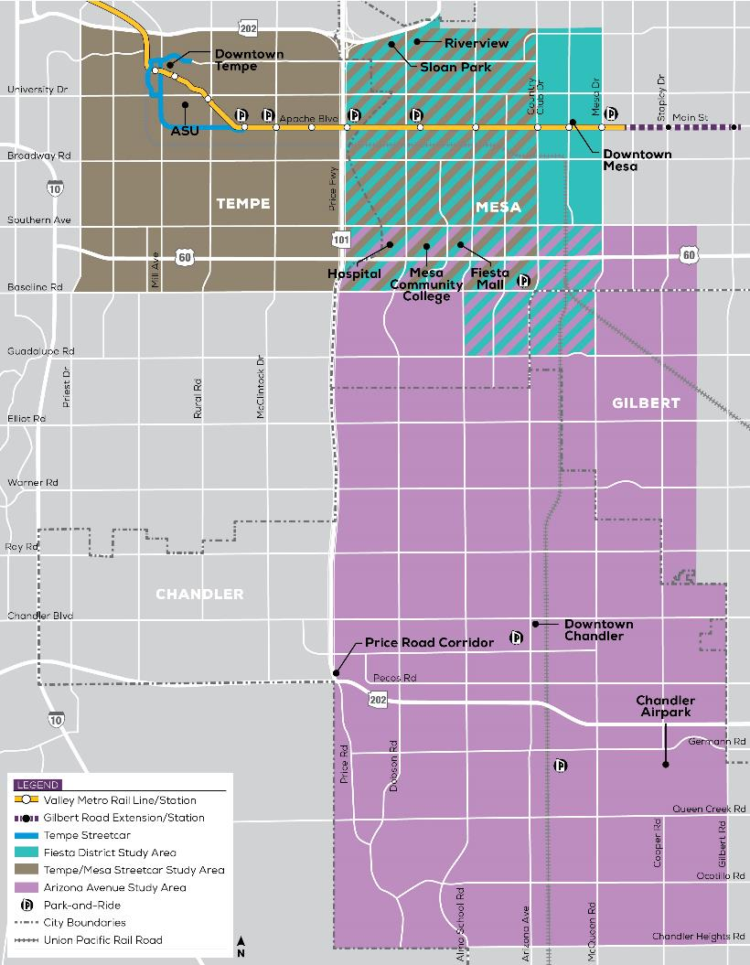
Related Projects
Fiesta District Alternatives Analysis
Completion in summer 2020
Tempe/Mesa Streetcar Feasibility Study
Completion in summer 2020
Arizona Avenue Alternatives Analysis
Ongoing
Tempe Streetcar (under construction)
Open for operations in 2021
Notes:
Explain how this study fits in
Explain how we will make sure results are consistent/incorporated

Slide 10
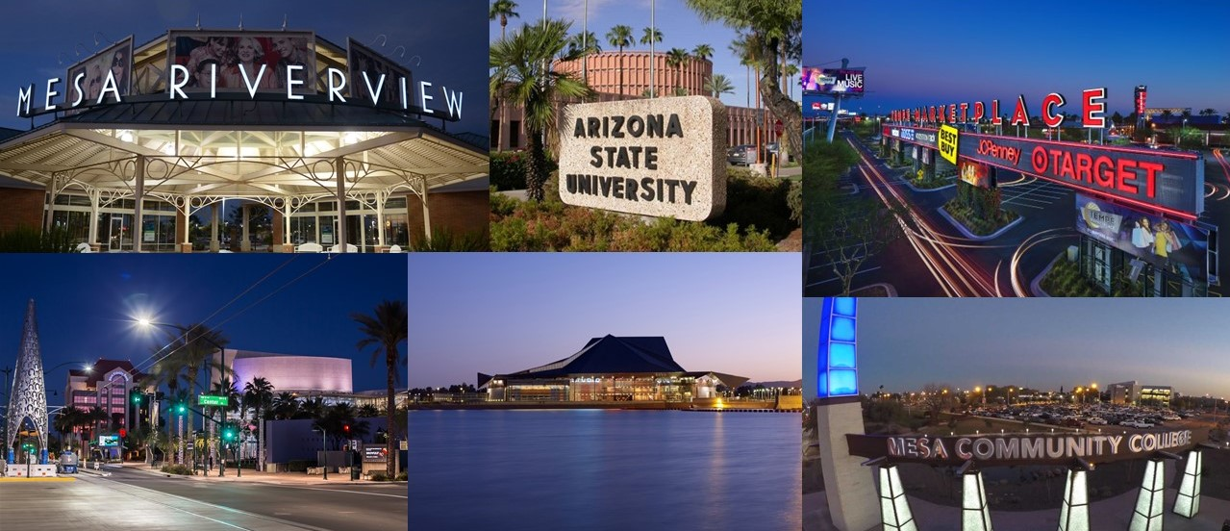
Next Steps
Final detailed analysis of prioritized corridors
City Council recommendation in mid-2020
Regional Transportation Plan
Prop 400 E

Slide 11
Thank You

Slide 12
Tier 2 Evaluation Preliminary Results
*
*
*
Corridor Options | Mobility | Access | Impacts | Land Use/ Econ Dev. | Costs | Efficiencies | Score | Rank
Rio Salado East |  |  |  |  |  |  | 79 | 1
Dobson, Southern, C.Club |  |  |  |  |  |  | 69 | 3
Mill Ave |  |  |  |  |  |  | 66 | 4
Rural Rd |  |  |  |  |  |  | 70 | 2
Rio Salado West |  |  |  |  |  |  | 65 | 5
High Performing
Medium Performing
Low Performing
Notes:
Referential, and as-needed only in case there are questions that require additional info when discussing slide 8

