Slide 1


TDM and TMA Plan
&
Mobility Hubs Plan
Marilyn DeRosa –Engineering and Transportation Department
Shannon Scutari - Scutari and Company
Jim Townsend – Wilson &Company, Inc.
Sasha Jovanovich-CR Associates
Development Review Commission
May 25, 2021
Notes:
First off, let me start by thanking you all for your time today.
My name is Robert Yabes with Engineering and Transportation , Im the principal planner in charge of the transportation planning group and the acting Project Manager___. I’m joined today by the consulting team: Shannon Scutari - public participation consultant; Jim Townsend- Lead consultant for TDM/TMA; and Sasha Jovanovich for the Mobility Hubs.
Although there are 2 projects, these projects are interrelated that it is better to present them together. It will be apparent as we proceed with the presentation.
Today you’ll hear a brief overview of what these projects are about and a brief presentation of definitions to familiarize yourself with.
https://nacto.org/covid19-rapid-response-tools-for-cities/

Slide 2

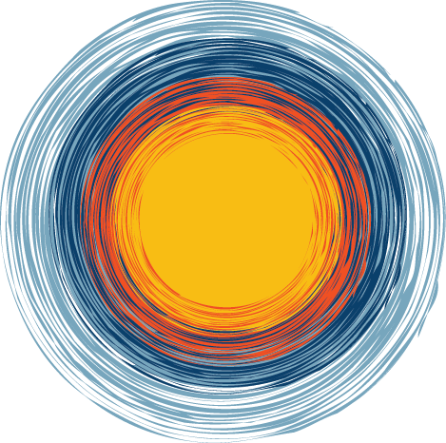
Agenda
Overview
Presentation
  Transportation Demand Management
  Transportation Management Association
  Mobility Hubs
Next Steps, Q&A
Notes:
First off, let me start by thanking you all for your time today.
My name is Robert Yabes with Engineering and Transportation , I’m the principal planner in charge of the transportation planning group and the acting Project Manager___. I’m joined today by Marilyn De Rosa The Department director for Engineering and Transportation and the consulting team: Shannon Scutari - public participation consultant; Jim Townsend- Lead consultant for TDM/TMA; and Sasha Jovanovich for the Mobility Hubs.
Today you’ll hear a brief overview of what these projects are about and a brief presentation of definitions to familiarize yourself with. Although there are 2 projects, these projects are interrelated that it is better to present them together. It will be apparent as we proceed with the presentation.
First off, let me start by thanking you all for your time today. You’ll soon be hearing from me and other members of the project team but let me first give you a roadmap for our meeting.
My name is ___ with ___. I’m joined today by City staff from ___ and our project consultants for these important strategy plans.
Today you’ll hear a brief overview of what these projects are about, a brief presentation of definitions to familiarize yourself with,

Slide 3


Council Priorities
Quality of Life
3.26: Achieve a multimodal transportation system (20-minute city) where residents can walk , bicycle, or use public transit to meet all basic daily, non-work needs.
3.27: Achieve a Travel Time Index average at or below 1.25 along major streets during rush hour traffic with no individual segments exceeding 2.0.
Sustainable Growth & Development
4.18: Reduce community Greenhouse Gas (GHG) emissions by 80% of 2015 levels by 2050 and achieve community carbon neutrality by 2060.
Notes:
The projects are strongly correlated with 3 City Council Priorities.
First is our 20-minute city goal, which is the idea that residents should be able to meet their daily needs within a 20 minute walk, bike ride or transit trip.
The second is our performance measure for traffic congestion along major streets.
And the last is our Greenhouse Gas Emissions Goal, our community carbon reduction goal.
The projects we are talking about today are strongly correlated to at least three City Council Priorities. The first is what we commonly refer to as our 20 minute city goal, which is the idea that residents should be able to meet their daily needs within a 20 minute walk, bike ride or transit trip. The second is our performance measure for traffic congestion along major streets. And the last is an important goal to allow for sustainable growth and development, which is our community carbon reduction goal.

Slide 4
Tempe’s Vision
Sustainable Tempe
  The City of Tempe is dedicated to growing a sustainable city alongside community stakeholders to be resilient for our future. Tempe is taking action to reduce emissions and cultivate resilience by focusing on the guiding principles of fiscal responsibility, enterprise, equity, engagement, and effectiveness.
Notes:
Tempe has a sustainable vision that is about more than just being green.
The goal is to reduce emissions and cultivate resilience by focusing on principles of fiscal responsibility, enterprise, equity, engagement, and effectiveness.
You will hear these themes consistently in our discussion today.
Tempe has a sustainable vision that is about more than just being green. The goal is to reduce emissions and cultivate resilience by focusing on principles of fiscal responsibility, enterprise, equity, engagement, and effectiveness.
You will hear these themes in our discussion today.

Slide 5
Plans
TDM & TMA Plan
  Transportation Demand Management (TDM) Evaluation & Plan
  Transportation Management Association (TMA) Evaluation & Plan
Mobility Hubs Plan
  Active Transportation Trip Demand, System Potential, Hub Sites, Hub Amenities, and Hub Designs
  Draft and Final Plan
Notes:
We are hear to talk about two important planning projects that are directly related to each other.
The first is a bit of alphabet soup but bear with me. The Transportation Demand Management Plan (or TDM) is a plan for how the city will operate and manage its multimodal transportation system and will include city strategies to improve system efficiency and effectiveness. The TMA Plan (which is an acronym for Transportation Management Association) is about creating a forum for public-private partnerships and collaborations for a shared goal of community mobility. The Mobility Hubs Plan is about creating a network of locations where people can easily access transportation alternatives to reduce single occupancy vehicle trips.
The

Slide 6
What do these projects accomplish?
Accomplish community sustainability goals and growth demands.
Establish partnerships for private/public collaboration for transportation/mobility.
Strategically assist at the scales between the Region and the Employment Site.
  Transportation Demand Management (TDM) – enhances system efficiency and promotes use of multi-modal investments.
  Transportation Management Associations (TMA) – creates a forum for collaboration.
  Mobility Hubs – provides the infrastructure for a variety of transportation choices.
Notes:
These projects will accomplish our community sustainability goals and also meet our growth demands.
These projects will establish private/public collaborations around transportation and mobility.
And these projects will help us to strategically assist in the scales between the Region and the Employment Site. You’ll hear me talk more about these scales later in the presentation.
So, be thinking of these topics in this way. TDM is about enhancing system efficiency and promoting multimodal investments. TMA is about creating a forum for collaboration on TDM. And Mobility Hubs is about providing the infrastructure for those transportation choices.

Slide 7

TDM
Transportation Demand Management
Notes:
I’ll quickly go over these slides that help to define what TDM really is about.

Slide 8
TDM Defined
Transportation Demand Management (TDM)
  Application of strategies aimed at improving efficiency and effectiveness of the transportation system
  Targeted policies focused on balancing land use and transportation
Results
  Reduces travel demand, VMT and congestion (focuses on reducing single occupancy vehicle trips)
  Redistributes travel demand (routes and travel times)
  Provides travel choices and options
  Supports a healthier community
  Increases safety
  Improves air quality
  Provides healthy economic conditions
  Supports employers’ recruitment/retention, sustainability and public relations goals
Notes:
TDM is about applying strategies that improve efficiency and effectiveness of the transportation system, by targeting policies that balance land use and transportation.
In doing this we can reduce travel demand, vehicle miles travelled and overall congestion by focusing on reducing single occupancy vehicle trips.
We can also do this by redistributing the demands across routes and travel times.
The end result is providing options and choices, which results in a healthier community, increased transportation safety, improved air quality, and healthy economic conditions. One of the reoccurring themes of TDM conversations is how it correlates to corporate goals for recruitment and retention as well as corporate sustainability and public relations goals.

Slide 9
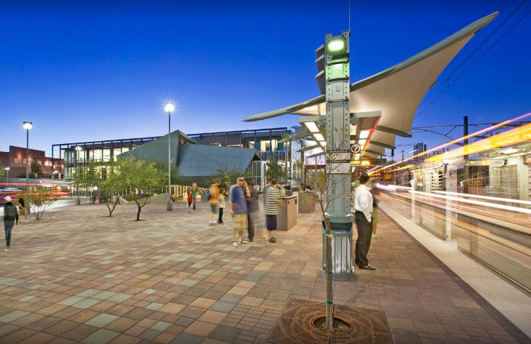
TDM Examples (infrastructure)
Public transportation
Notes:
These slides that follow will illustrates infrastructure examples.
For example, public transportation (like light rail, streetcar, and the bus) are critical components of TDM.

Slide 10
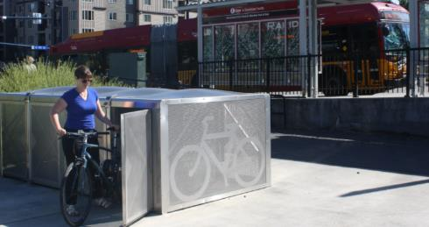
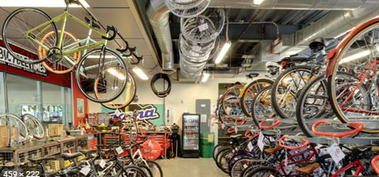
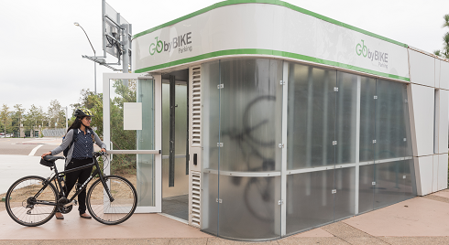
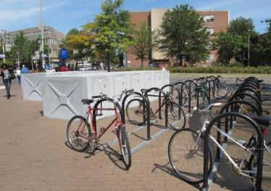
TDM Examples (infrastructure)
Bicycle parking and support facilities
(lockers, showers, repair)
Notes:
Additionally, bike parking and associated support facilities can be either publicly or privately provided. Like lockers, showers, and repair stations.

Slide 11
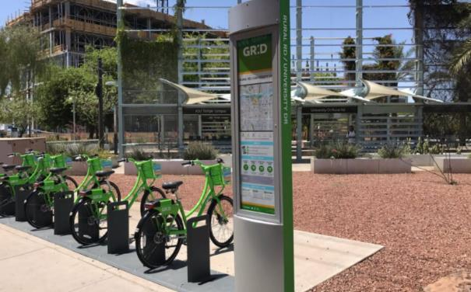
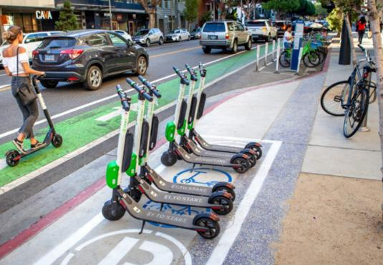
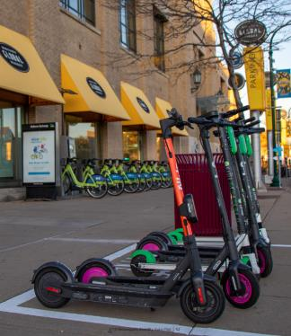
TDM Examples (infrastructure)
Shared micro-mobility parking
Notes:
Encouraging people to use small mobility devices that are for rent as a convenience for short trips.

Slide 12
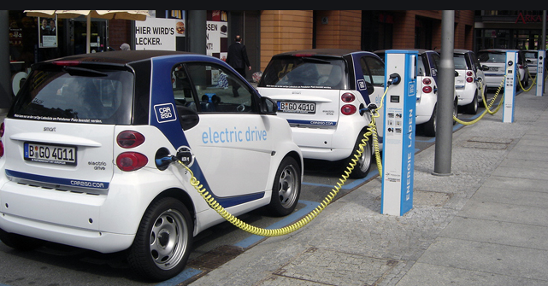
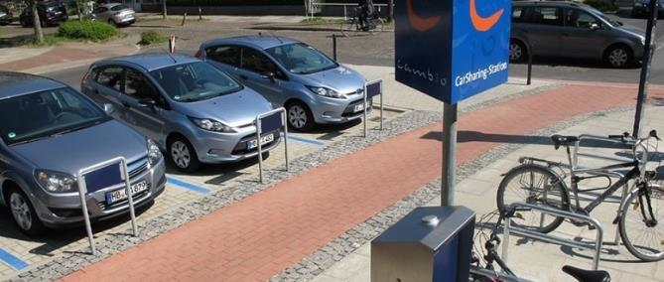
TDM Examples (infrastructure)
Car share parking (often with electric charging)
Notes:
Having car share parking and often with electric vehicle charging

Slide 13
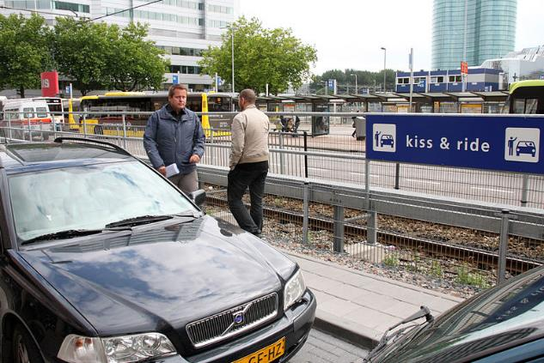
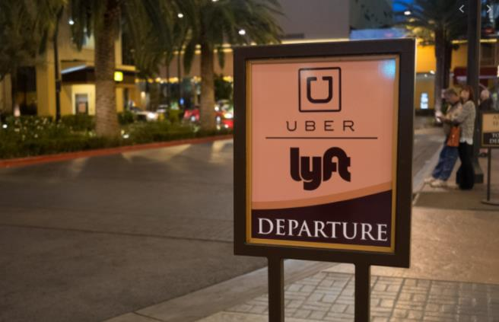
TDM Examples (infrastructure)
Convenient passenger pick-up and drop-off
Notes:
Having passenger pick-up and drop-off locations

Slide 14
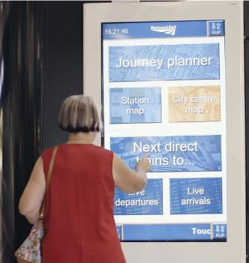
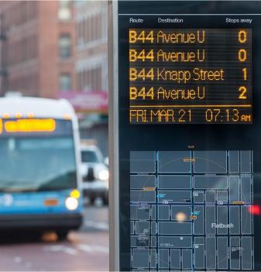
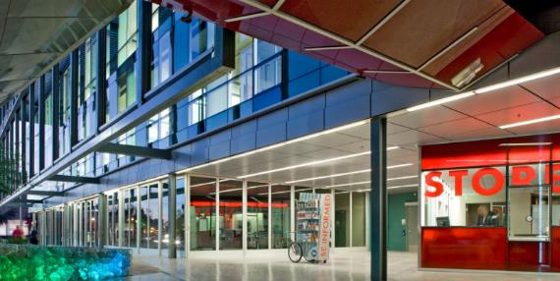
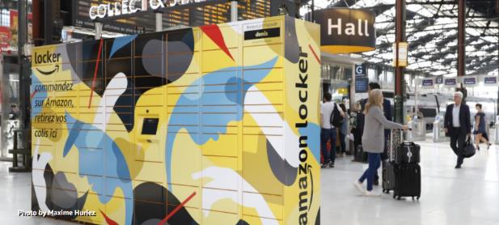
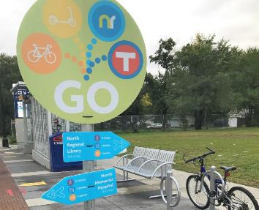
TDM Examples (infrastructure)
Travel and trip planning information
Comfortable waiting areas
Wayfinding to surrounding destinations
Kiosks, retail, mobile services, delivery lockers
Notes:
And having other information and comfort features like: trip planning information, waiting areas, wayfinding signage, and kiosks, retail, mobile services, and delivery lockers that reduce or concentrate delivery trips.

Slide 15
TDM Examples (programs)
Incentives:
Policies:
  Transit passes
  Rideshare programs
  Parking cash out
  Guaranteed ride home
  Land use patterns
  Strategy compliance
  Enforcement
  Telework / Compressed Work Week / Flex Schedule
Notes:
In addition to infrastructure, some programming strategies include subsidized transit passes, rideshare programs, parking cash out, and guaranteed ride home. From a policy perspective there are action that government agencies can take like addressing land use patterns, working on strategies with area employers, the County does enforcement, and then also employers can do things like telework, compressed work weeks or flex schedules.

Slide 16
TDM Examples (scale of applications)
Context Considerations:
  Region*
  City
  Neighborhood, District, or Corridor
  Employment Site*
  Residential Site
  * Existing TDM programs in the region
Notes:
Now I want to spend a little time on this slide to illustrate why these plans are different from what we already have. In our region, we have TDM efforts occurring at the regional scale and the individual employer scale. So, Maricopa County requires that employers with 50 or more employees implement TDM strategies. Valley Metro provides some information and education for these purposes. And MAG encourages member agencies to support regional investments in transit, HOV lanes, etc.
But what we don’t yet have in this region is a focus on the other scales. So, what happens when someone begins their commute at a residential location that doesn’t provide transportation choices? What can be done especially in multifamily developments to provide transportation choices on site? And then what can the city (in partnership with private stakeholders) do to create strategies for congested corridors, districts, or neighborhoods. And what could be city-wide strategies? These scales of TDM strategies have not yet been done in our region and we see these as missed opportunities.

Slide 17
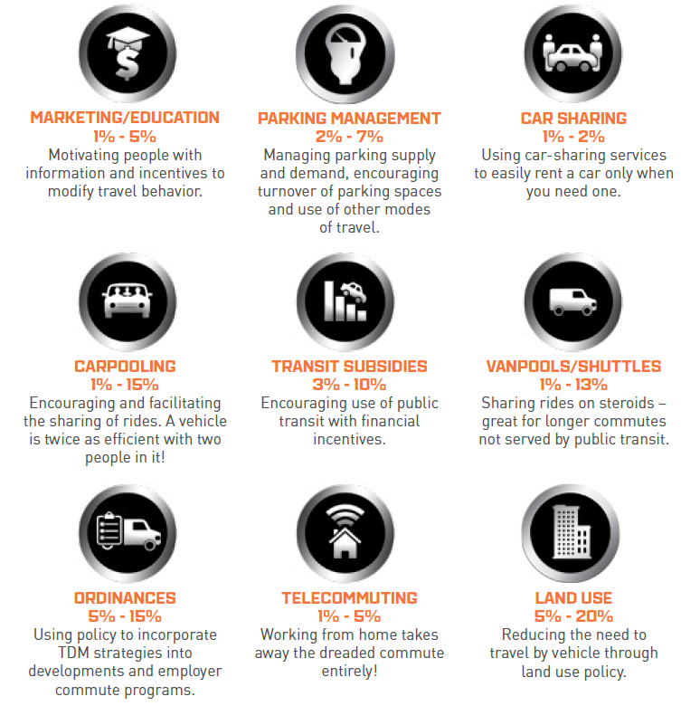
TDM Impact
  TDM Strategies Have Impact
  National research shows that TDM strategies can reduce vehicle miles traveled by the following percentages*
  *Based on data from the research report, “Quantifying Greenhouse Gas Mitigation Measures,” by the California Air Pollution Control Officers Association. August 2010
Notes:
TDM strategies have been proven to be very effective. As the graphic at right illustrates, while there are many types of TDM strategies and then all make pretty small percent changes, when you start combining these strategies together is where we can see significant reductions in vehicle miles traveled and single occupancy vehicle trips.

Slide 18
What TDM is About
  Shifting priority away from driving alone
  Collaborating with employers and residents
  Improving travel options
  Educating people about their travel options
Notes:
In summary… TDM is about shifting priority away from driving alone. Its about collaborating with the employers and residents. About improving travel options. And about education people about those options.

Slide 19
TMA
Transportation Management Association
(a TDM strategy)
Notes:
And this is where a TMA can be really instrumental.

Slide 20

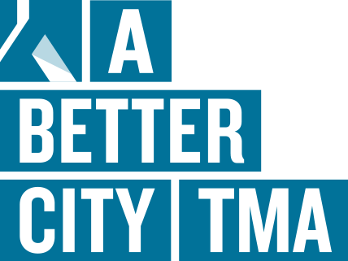


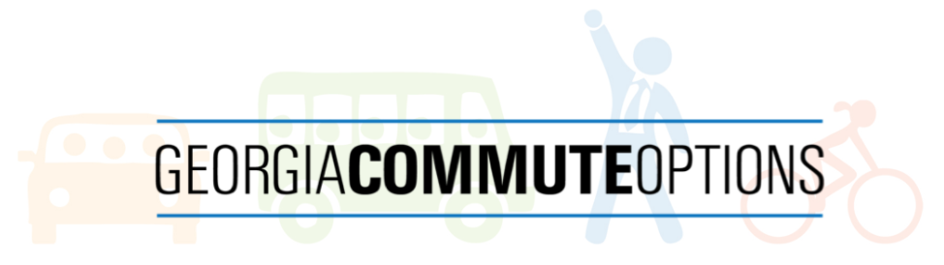
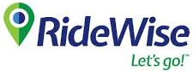


TMA Defined
  Transportation Management Association (TMA)
  Provide the institutional framework
  Support for TDM programs and services
  Establishes public-private partnerships
  Can be custom-designed to local needs
Results
  Technical and policy resource
  Pool resources
  Commute strategist
Notes:
A transportation management association provides an institutional framework to support TDM programs and strategies by establishing a public-private partnership. While there are hundreds of TMAs in the US, no two are alike, and we have an opportunity to custom design a TMA that best meets our community’s needs. The TMA provides technical and policy resources, they allow for resources to be pooled across organizations and they are commute strategists.

Slide 21
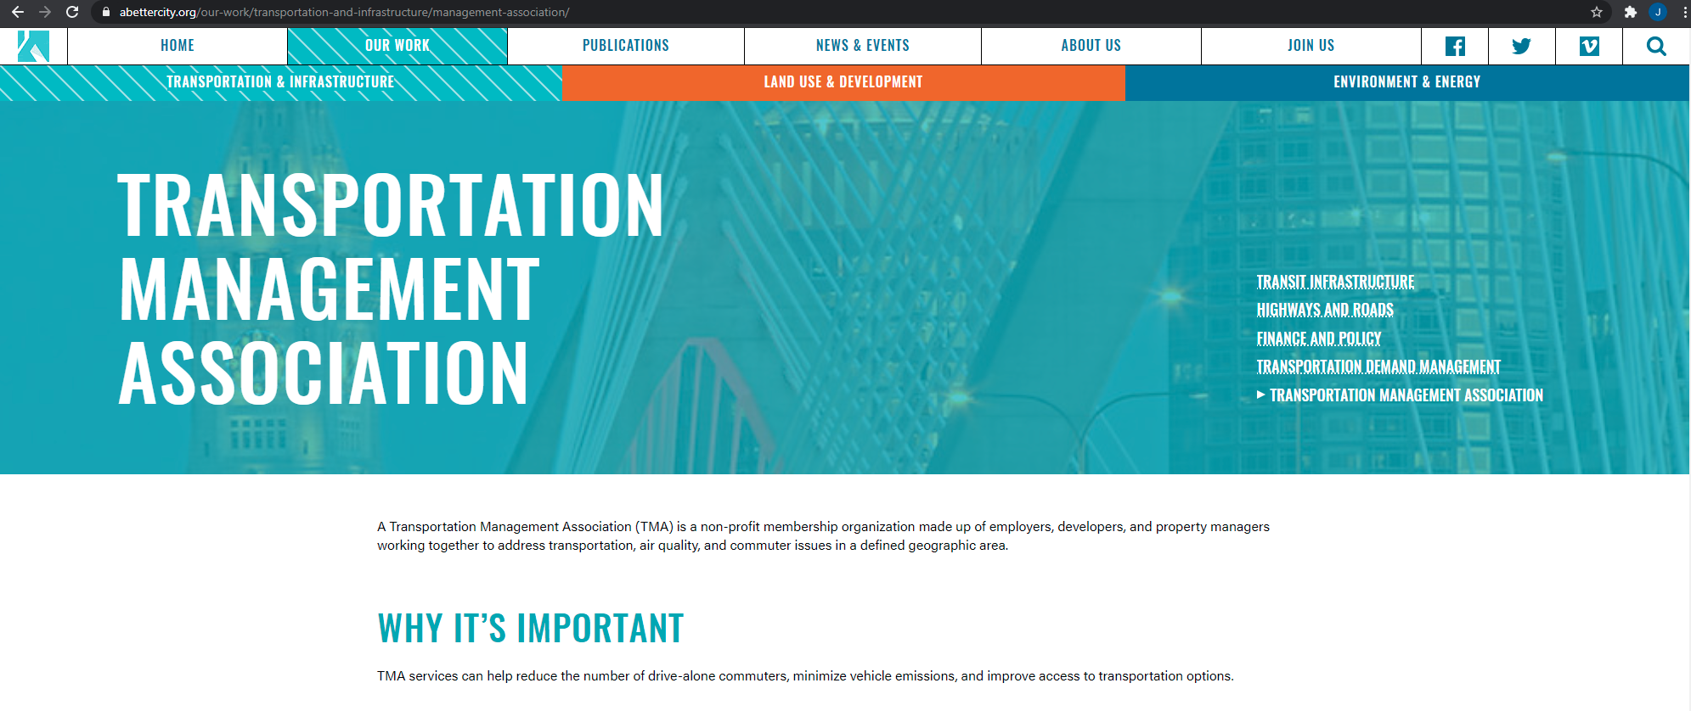
TMA Example (community oriented)
Source: A Better City, Boston TMA
Notes:
An example of one TMA is a Better City TMA in Boston. This TMA is more community oriented. While they focus on transportation and infrastructure, they also advocate for wise land use, development, environment and energy decisions.

Slide 22
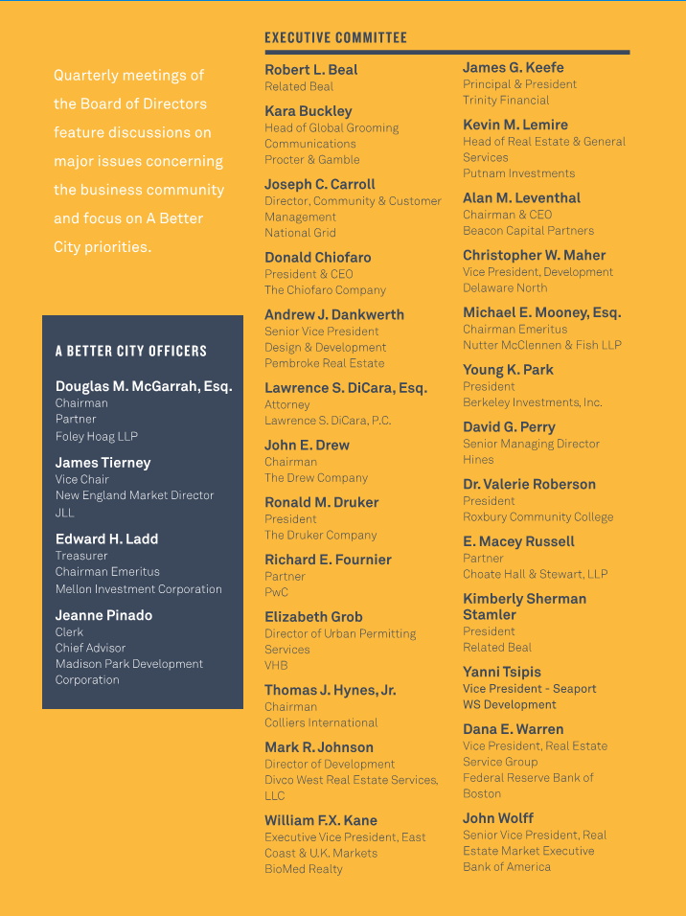
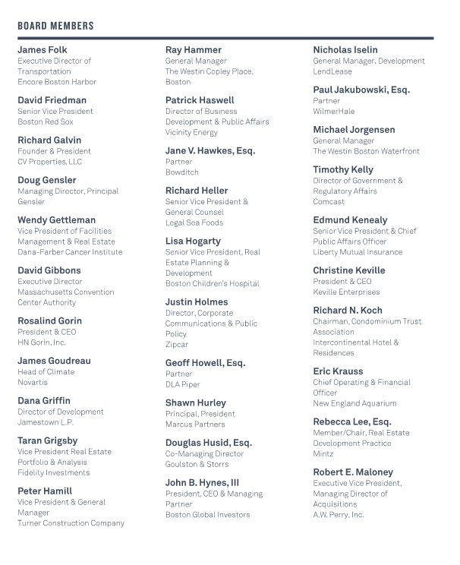
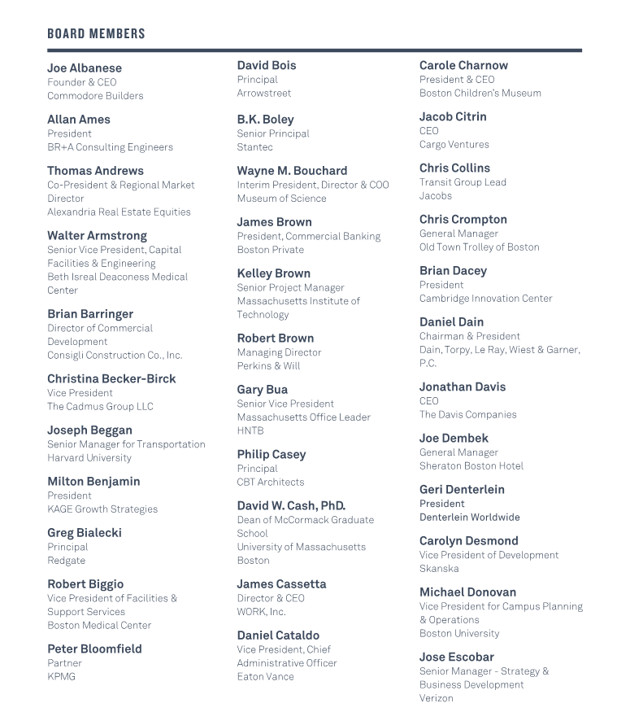
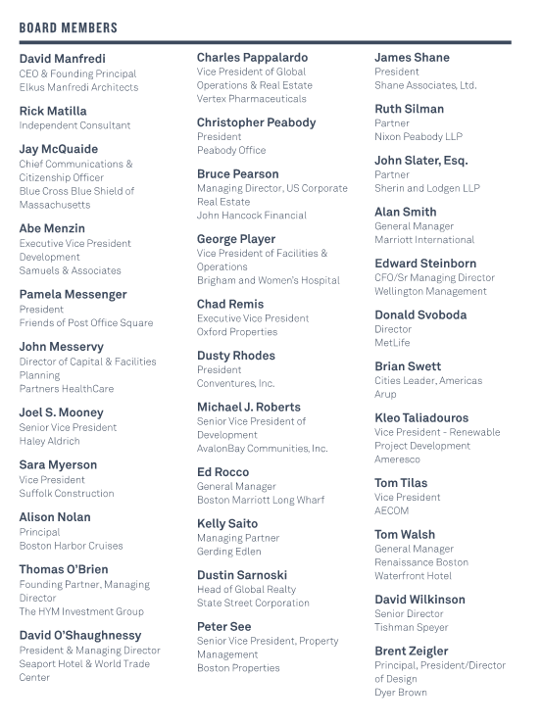
TMA Example (member led)
Source: A Better City, Boston TMA
Notes:
An important characteristic of a TMA is that it is not another government entity. It is a member led organization. Those members often include employers, property management companies, private mobility companies, and the government usually has a seat at the table as well.

Slide 23
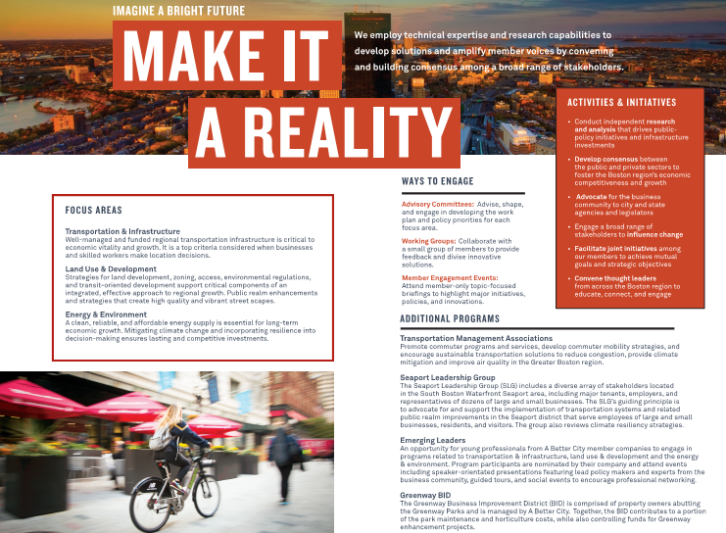
TMA Example (results focused)
Source: A Better City, Boston TMA
Notes:
TMAs are results focused. They conduct research and analysis, develop consensus, advocate, influence change, facilitate joint initiatives, and convene thought leaders.
There is still quite a bit of work for the consultants to do in this area, and stakeholder engagement through this process will help to inform the TMA questions.

Slide 24
Mobility Hubs
(a TDM strategy)
Notes:
Mobility Hubs is another type of TDM strategy.

Slide 25
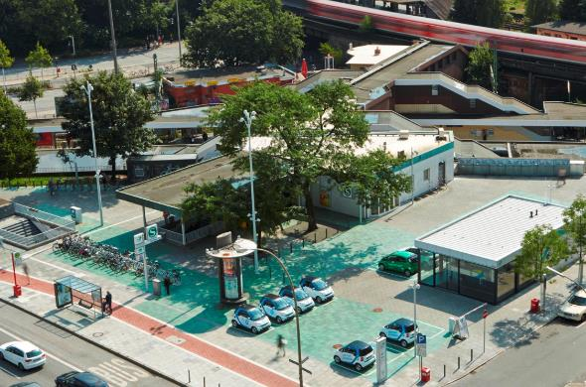
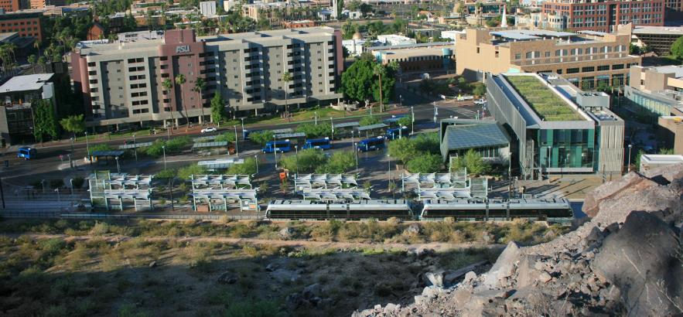
Mobility Hubs Working Definition
Mobility Hubs are places which combine the resources of multiple modes of transportation together in one physical location, designed to help reduce the need for vehicle ownership and single occupancy driving trips.
Notes:
A mobility hub is about combining modes of transportation in locations that reduce the need for vehicle ownership and reduce single occupancy driving trips.
In the photo at left you can see wayfinding signage, a bus stop, car share parking and EV charging, travel information signage, bike share, and a light rail station.
The photo at right is the Transit Center, which already has many of the components of a mobility hub but is maybe missing a feature or two.

Slide 26
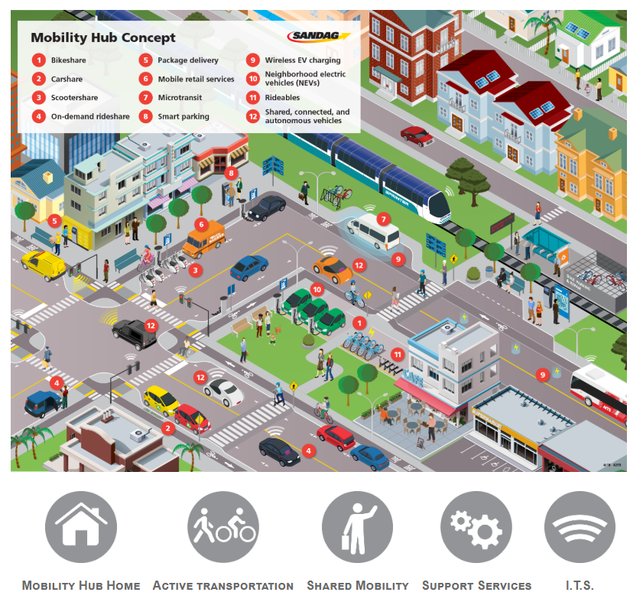
Mobility Hub Example
Source: SANDAG, CA
Notes:
While the previous slide showed singular site locations, this graphic illustrates how those features could be spread over a block or in a district.

Slide 27
Five Mobility Hub Contexts to be Envisioned
Gateways to major destinations/transit centers
Neighborhood park locations
Park and ride facilities
Curbside locations
Private developments
Notes:
In Tempe we believe we have five different contexts where mobility hubs could be applied. I’ll show photos on the next slides to illustrate examples of each.

Slide 28
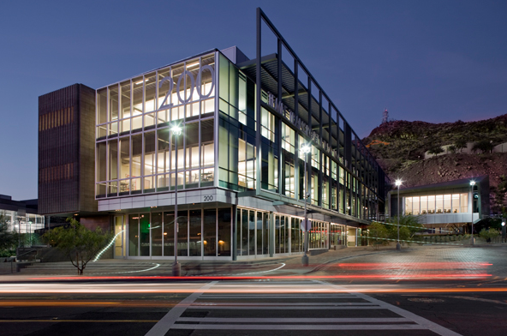
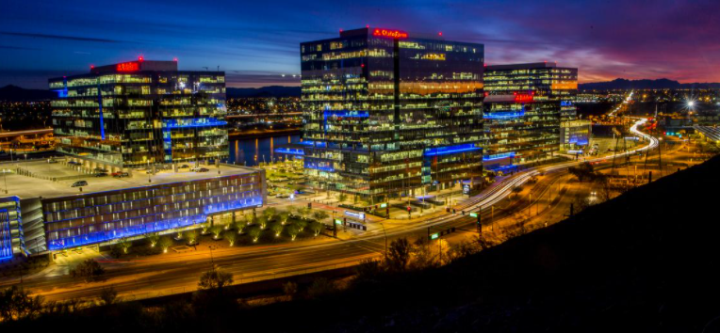
Five Mobility Hub Contexts to be Envisioned
Gateways to major destinations/transit centers
Notes:
Gateways to major destinations are logical locations because they are congested areas. The photos here show the Transit Center and Rio Salado corridor as a few examples.

Slide 29
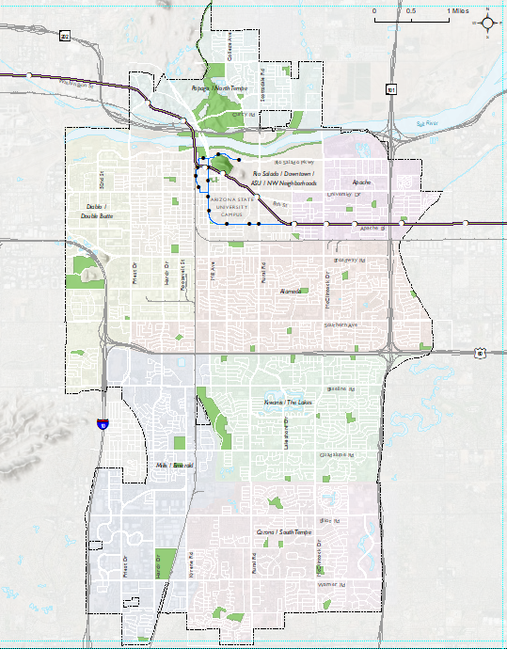
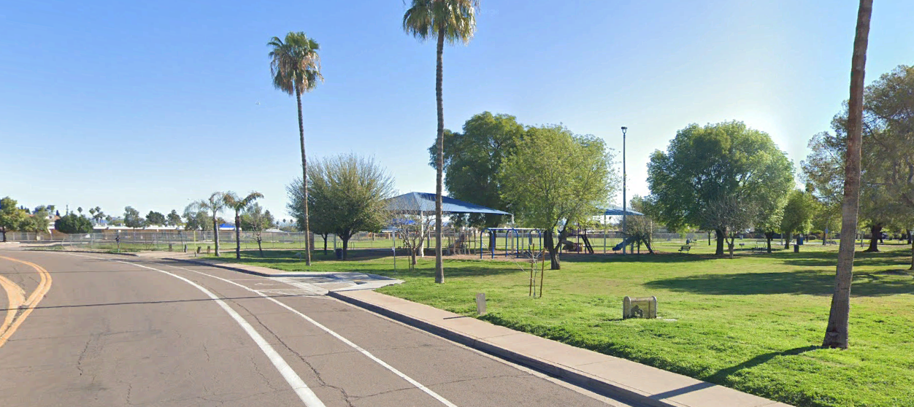
Five Mobility Hub Contexts to be Envisioned
Neighborhood park locations
Notes:
On the much smaller scale, neighborhood parks are valuable assets where transportation options could be placed. These options would allow for people to more easily access parks and would also allow nearby residents to utilize mobility hub features to access destinations away from parks. In Tempe we have parks at about a mile spacing and many are not along the arterial streets which means they provide a good origin point for residents starting their trips or ending their trips at the end of the day.

Slide 30
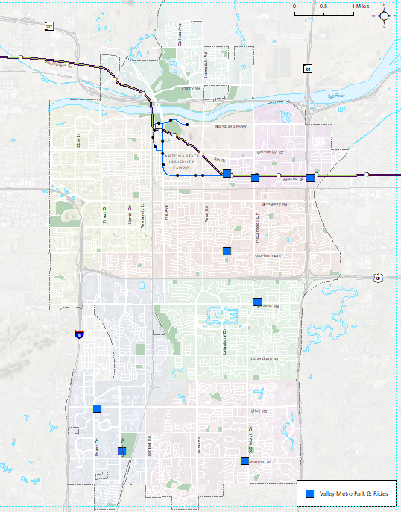
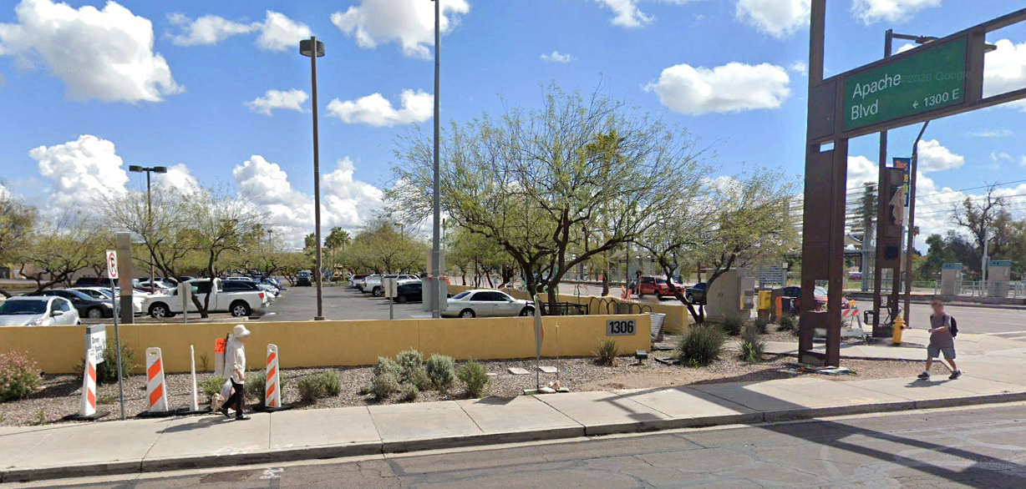
Five Mobility Hub Contexts to be Envisioned
Park and ride facilities
Notes:
The next context is to leverage our existing park and ride network. How can we re-envision what a park and ride is? Can it be more than just parking your car and getting on transit or in a carpool? What if it’s a location for EV charging or for autonomous vehicle queueing, or for delivery kiosks?

Slide 31
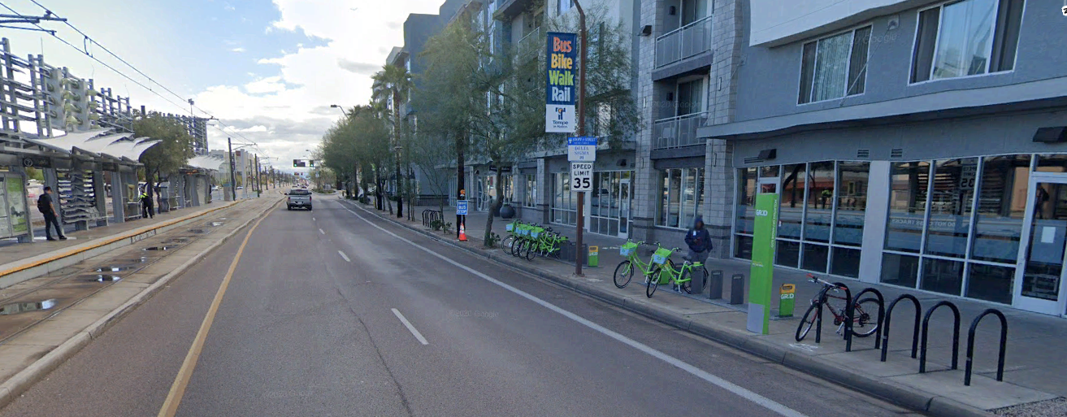
Five Mobility Hub Contexts to be Envisioned
Curbside locations
Notes:
At the very smallest scale we have curbside locations. Our curb space has been very valuable. How do we plan for bike share, scooter share, delivery zones, rideshare drop off/pick up, etc.

Slide 32
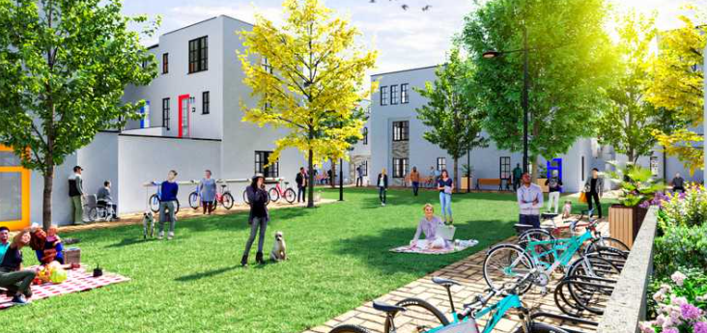
Five Mobility Hub Contexts to be Envisioned
Private developments
Culdesac Tempe (culdesac.com)
Notes:
And last but not least, we have private development. One of our greatest opportunities as a region is how fast we are growing. And we have some developments that are integrating these features so they can be a landlord of choice. Culdesac is one of them which is a multifamily residential development. But other office developments are also focusing on how they can provide commuting features to keep their tenants longer. The City wants to encourage developers to incorporate features like mobility hubs as a way to reduce their traffic impact associated with their development.

Slide 33
Next Steps
TDM, TMA and Mobility Hubs
Notes:
Thank you all for participating in this dialogue. I’ll just take a few minutes to wrap things up.

Slide 34
PUBLIC MEETING
  May 22, 2021 at 9:30 a.m.
  Join the meeting at tempe.webex.com
  Event number: 187 578 0828
  Event password: TIM
  Audio conference: To receive a call back, provide your phone number when you join the event, or call the number below and enter the access code. United States Toll +1-408-418-9388
  Access code: 187 578 0828
  May 26, 2021 at noon
  Available on Either Project Webpage
  www.tempe.gov/TDM or www.tempe.gov/mobilityhubs
Notes:
Our next steps include launching a community survey. We are broadly using the term community here to mean residents, visitors, employees, basically anyone who uses the transportation system in Tempe.
This survey will stay open until end of May. In mid-May we will be hosting public meetings about these projects, so be on the lookout for those announcements.

Slide 35
PUBLIC MEETING
  May 26, 2021 at noon
  Join the meeting at tempe.webex.com
  Event number: 187 004 9898
  Event password: TIM
  Audio conference: To receive a call back, provide your phone number when you join the event, or call the number below and enter the access code. United States Toll+1-408-418-9388
  Access code: 187 004 9898
  Available on Either Project Webpage
  www.tempe.gov/TDM or www.tempe.gov/mobilityhubs
Notes:
Our next steps include launching a community survey. We are broadly using the term community here to mean residents, visitors, employees, basically anyone who uses the transportation system in Tempe.
This survey will stay open until end of May. In mid-May we will be hosting public meetings about these projects, so be on the lookout for those announcements.

Slide 36
Survey
Online Community Survey
  Travel Behavior, Preferences, and Parking
  Locations and Destinations
  Programs and Amenities
  Demographic Data
  Available on Either Project Webpage
  www.tempe.gov/TDM or www.tempe.gov/mobilityhubs
Notes:
Our next steps include launching a community survey. We are broadly using the term community here to mean residents, visitors, employees, basically anyone who uses the transportation system in Tempe.
This survey will stay open until end of May. In mid-May we will be hosting public meetings about these projects, so be on the lookout for those announcements.

Slide 37
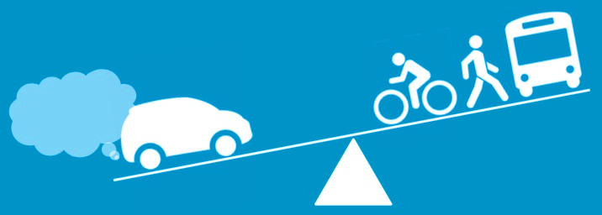
Questions
Shannon Scutari, Consultant, shannon@scutariandcompany.com
Robert Yabes, Transportation Planning Manager, Robert_Yabes@tempe.gov
www.tempe.gov/TDM
www.tempe.gov/mobilityhubs
Source: Mobility Lab
Notes:
And I’ll just conclude by leaving this slide up. You can write down my or Shannon’s contact information and jot down the project webpages.
Again, we thank you for your time today and hope to continue to have you involved in this process.

Slide 38
PROJECT SCHEDULE
Notes:
So now that we’ve provided definitions and examples for each of these terms: TDM, TMA and Mobility Hubs. I’m going to turn things over to Shannon to lead a discussion with you all, so we can better understand your issues, ideas and other thoughts regarding these topics.

Slide 39
Aligned Schedule
 | 1 | 2 | 3 | 4 | 5 | 6 | 7 | 8 | 9 | 10 | 11 | 12
Project Kick-off
Background & Analysis
Stakeholder & Public Engagement |  |  |  |  |  |  |  |  |  |  | 
Best Practices & Performance Metrics
Goals & Objectives
Strategy Options
TDM Implementation & Monitoring Plan
TMA Feasibility & Plan
TDM & TMA
 | 1 | 2 | 3 | 4 | 5 | 6 | 7 | 8 | 9 | 10 | 11 | 12
Project Kick-off
Stakeholder & Public Engagement |  |  |  |  |  |  |  |  |  |  | 
Data, Field Conditions, System Potential
Identification of Mobility Hub Sites
Menu of Mobility Hub Amenities
Mobility Hub Concepts
Draft and Final Plan
Mobility Hubs

