Slide 1
Smith Innovation Hub and Maker District
Design Guidelines
DRC Study Session
March 22, 2022

Slide 2
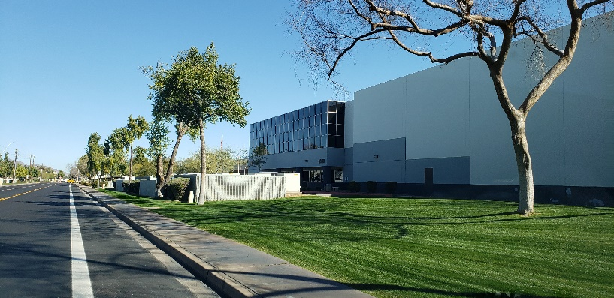
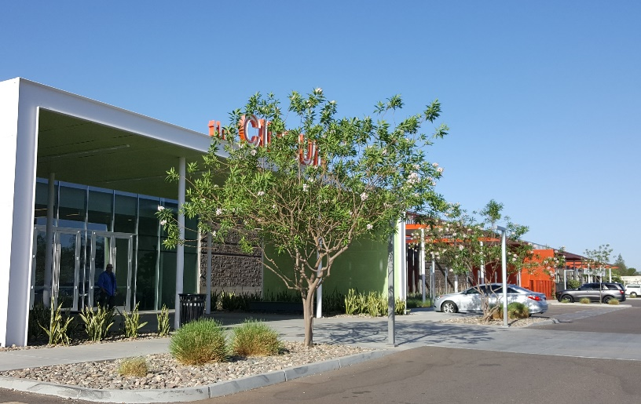
Agenda
Introduction
Smith Innovation Hub Existing Character
Maker District Existing Character
Outcomes of Public Outreach
Public Meeting Findings: Mixed-Use
Public Meeting Findings: Art Integration
Public Meeting Findings: Building Design
About the Guidelines
Table of Contents
Preamble and Goals
Design Guidelines
Operational Guidelines

Slide 3
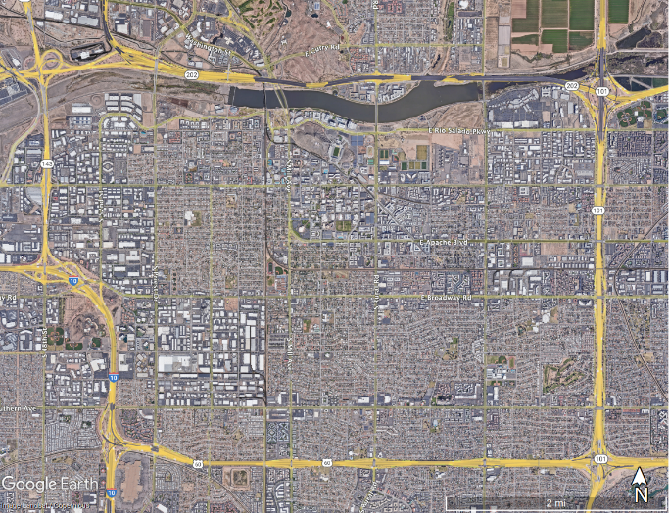
Introduction
Innovation Hub Initiative approved by Tempe City Council on March 1, 2018
Part of an economic development initiative to enhance key employment corridors
Promotes new investment, job creation, and placemaking
Attracts and retains a quality workforce
Eight hubs were identified
Smith Innovation Hub
Maker District

Slide 4
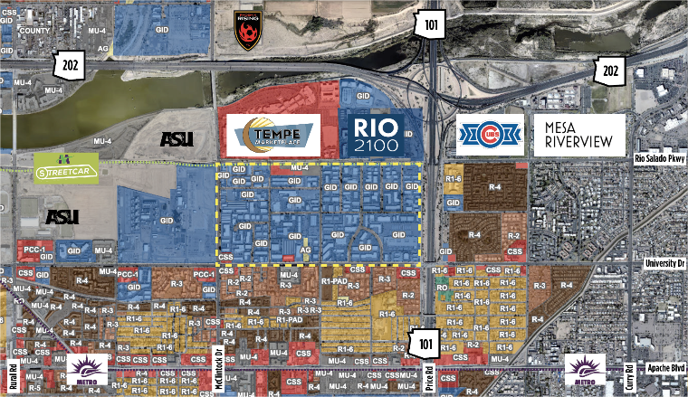
Smith Innovation Hub Existing Character
Most of the existing buildings were constructed between 1950 and 1970
Area was known for its industrial uses
Today mainly light industrial, office and retail uses:
High-tech manufacturing
Construction
Transportation/distribution
Consumer (primarily auto-related)
Advanced business
Retail services
Proximity to highways, airport, streetcar
Proximity to ASU
Residential to the south

Slide 5
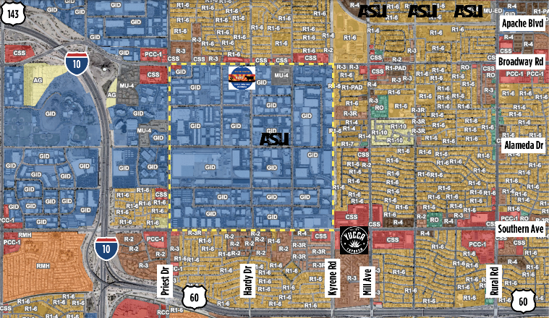
Maker District Existing Character
Almost one full square mile of commercial, industrial, manufacturing, & distribution uses
Food-centric processing, manufacturing, & packaging/distribution
Single family residential on 3 boundaries (north, east, south)
Hospitality on west
Proximity to highways, airport, streetcar
Proximity to ASU
Rail spurs

Slide 6
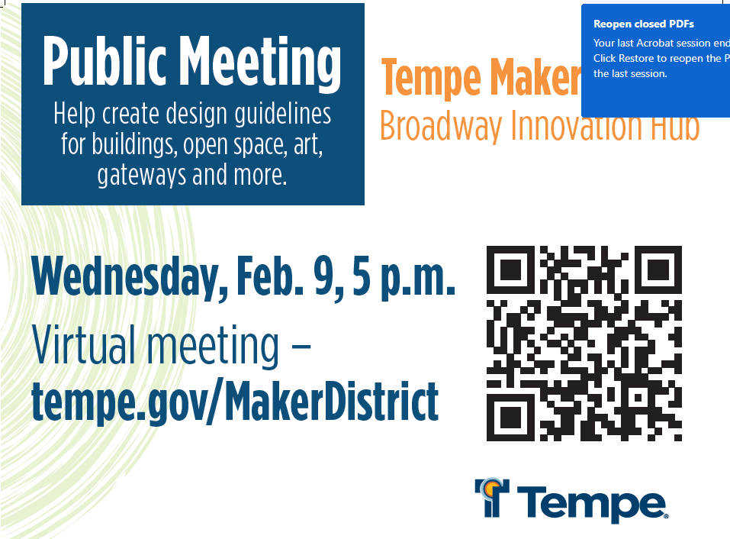
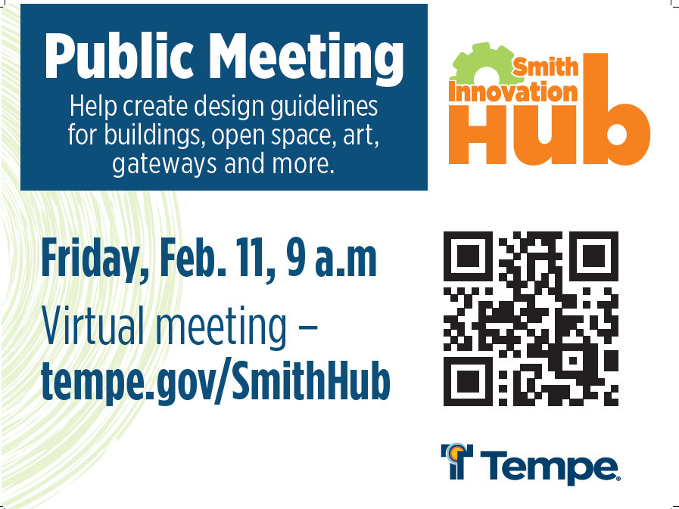
Public Outreach
01/20/2022 Arts and Culture Commission Meeting
01/24/2022 Sustainability & Resilience Commission Meeting
02/09/2022 Maker District Public Meeting (21public attendees)
02/11/2022 Smith Innovation Hub Public Meeting (13 public attendees)
03/22/2022 DRC Study Session
Upcoming:
04/28/2022 Council Meeting
05/10/2022 DRC Hearing
05/26/2022 Council Hearing

Slide 7
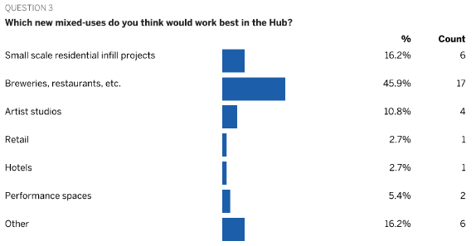
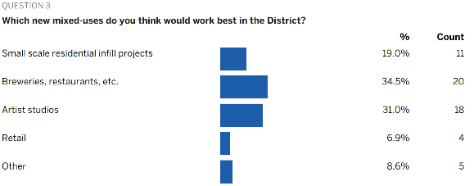
Public Survey Responses: Mixed-Use
Smith Innovation Hub Survey
February 2022
37 Responses
Maker District Survey
February 2022
59 Responses

Slide 8
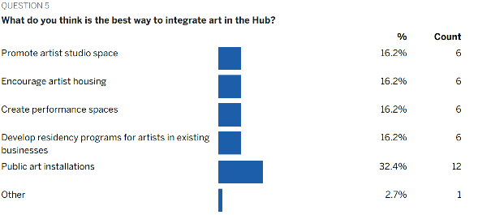
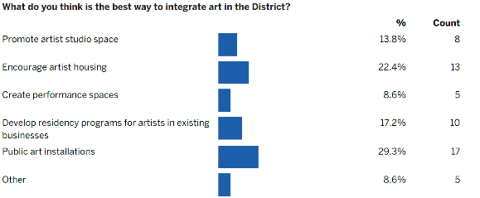
Public Survey Responses: Art Integration
Smith Innovation Hub Survey
February 2022
37 Responses
Maker District Survey
February 2022
59 Responses

Slide 9
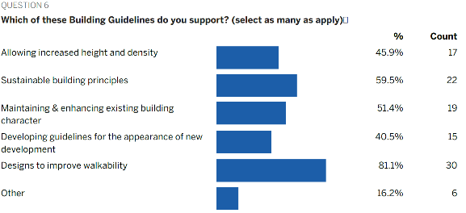
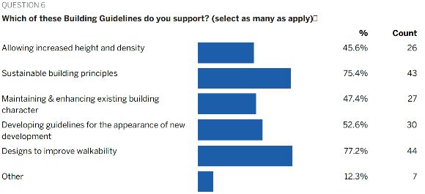
Public Survey Responses: Building Design
Smith Innovation Hub Survey
February 2022
37 Responses
Maker District Survey
February 2022
59 Responses

Slide 10
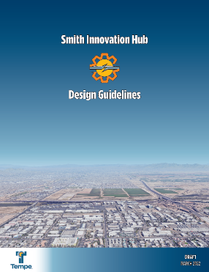
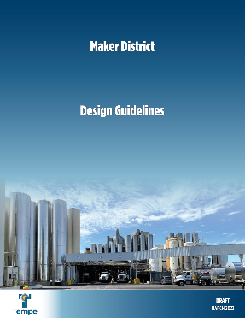
About the Guidelines
Policy-level advisory document that provides design and development principles and strategies without prescribing any regulatory requirements
Promote the transformation from existing light industrial character to energetic innovative mixed-use ecosystem
Maintaining and building upon the unique character of each hub/district
Not about displacing existing businesses but still encouraging new uses that are complementary
Making sure we are always incorporating, communicating, and celebrating existing and future successes in the hubs/districts
These guidelines incorporate short-term and long-term opportunities, goals, strategies, and solutions

Slide 11
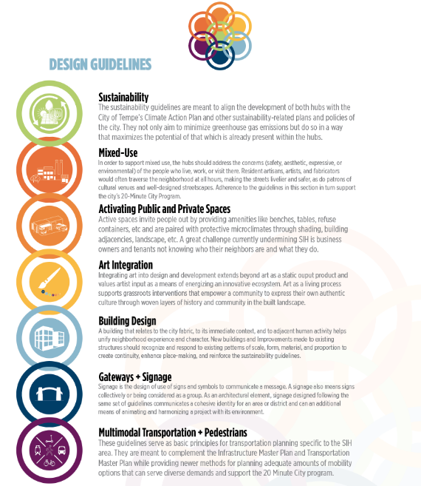
Table of Contents
Enhance and amplify the latent potential of the existing properties within the Hub
Emphasize authentic grassroots efforts
Many elements in the document achieve more than one objective
Prioritize innovation and creativity as opposed to spending a lot of money
These guidelines will reference prior policy documents etc.
Some of these chapters will be unique to the hubs while some can apply to others too
It is a living document to address short-term and long-term district transformation

Slide 12
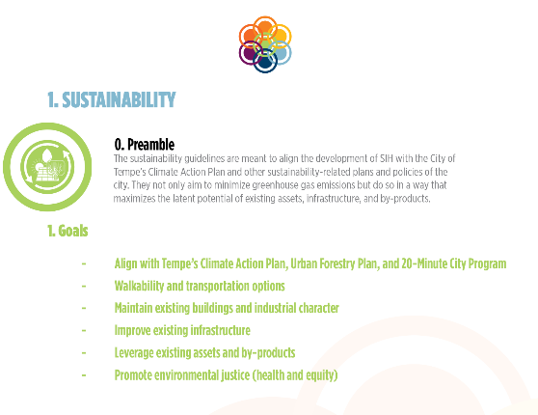
Preamble and Goals
The goals are a result of:
Previous studies
City programs
Meetings
Public Outreach and Surveys
They summarize what the following strategies and solutions, presented as guidelines, aim to achieve

Slide 13
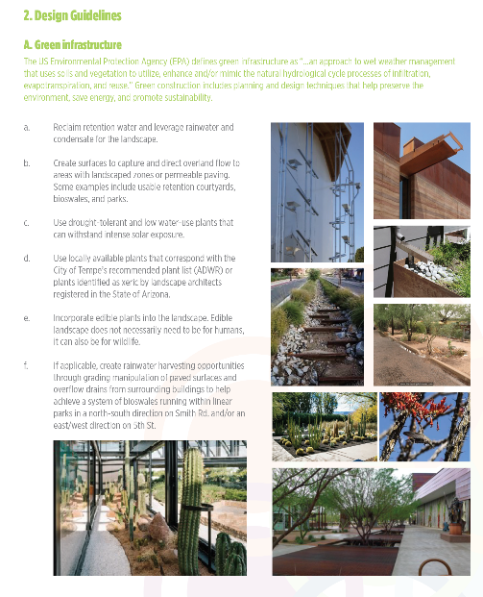
Design Guidelines
The design guidelines are a set of principles that are aimed at developers, architects, review boards etc. to guide the transformation of the hub.

Slide 14
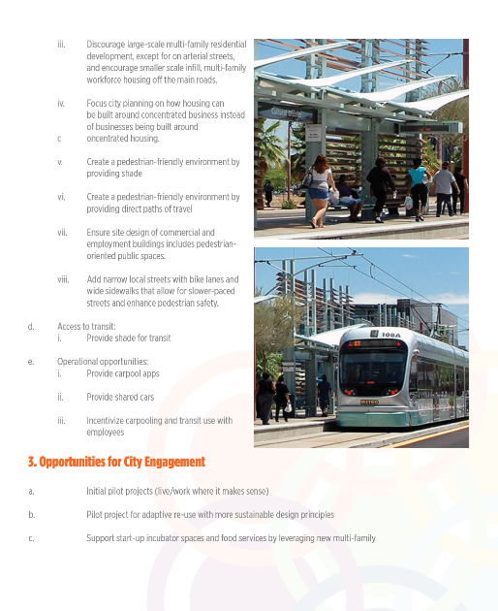
Operational Guidelines
The operational guidelines are high level strategies and solutions that are more relevant to ongoing building management issues
Identify opportunities for city engagement in nurturing the planned vision for the hub.

Slide 15
Thank you
Contacts
Jill Buschbacher. Jill_Buschbacher@tempe.gov
Ambika P. Adhikari. Ambika_Adhikari@tempe.gov
John Kane. jfkane@architekton.com

