Slide 1
Historic Preservation Plan and Inventory Update
Development Review Commission Study Session
April 12, 2022

Slide 2
Introduction
Zachary J. Lechner, Ph.D.
City of Tempe Historic Preservation Officer

Slide 3
Introduction
Archaeological Consulting Services
Lead Consultant
VINSONSTUDIO PLLC
Architectural Subconsultant

Slide 4
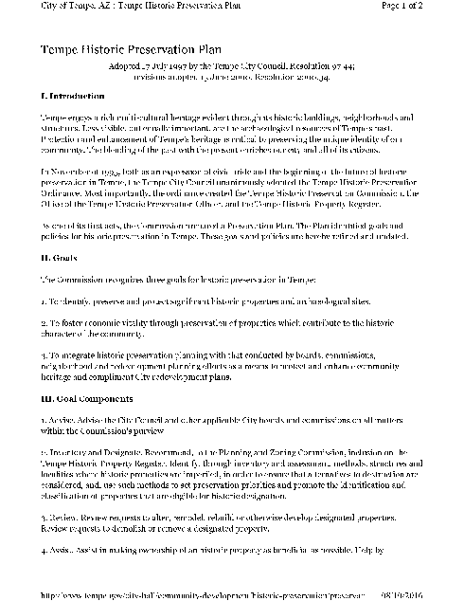
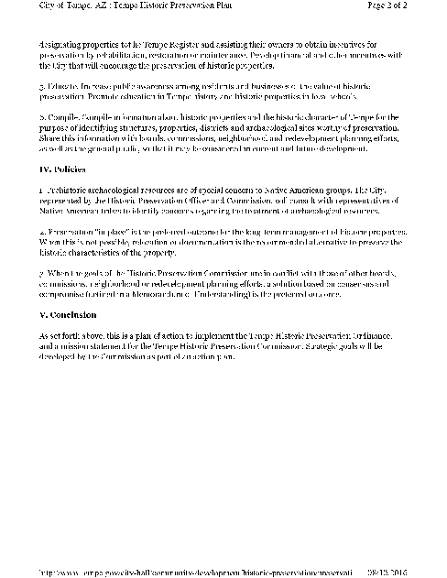
Preservation Plan Update
Rationale
The current plan (1997) is inadequate
Tempe has changed in the last 25 years
Goals and priorities need to be updated

Slide 5
Preservation Plan Update
Objectives
Evaluate existing plan, ordinance, and Historic Preservation Office / Historic Preservation Commission operations for successes and challenges
Review existing plan and ordinance to ensure applicable laws and regulations passed
and approved subsequent to the last updates are satisfactorily addressed
Identify and, when feasible, incorporate goals and priorities identified in the public outreach process and stakeholder consultation sessions (ASM, SHPO, the Four Southern Tribes, etc.) into the draft plan
Implement policies and practices consistent with the updated plan

Slide 6
Preservation Plan Update
Public/Stakeholder/Tribal Gov’t Outreach Process
Public meetings and presentations held on April 26, 2021, and October 20, 2021
Public survey, April-May 2021 (52 responses)
Multiple consultation meetings with Tribal representatives in 2021
Consultation with Historic Preservation Commission throughout 2021, and preliminary approval by HPC in November 2021
Consultation with Tempe Historic Preservation Foundation in August 2021

Slide 7
Preservation Plan Update
Public/Stakeholder/Tribal Gov’t Outreach Process
Comments solicited from relevant City agencies in February 2022
Plan sent to SHPO for review in March 2022
Ongoing revisions of plan based on feedback (2021-22)
Plan draft made available for public comment in April 2022
Presentation of revised plan to April 2022 meeting of Four Southern Tribes Cultural Resource Working Group

Slide 8
Preservation Plan Update
Main components of the plan
Vision and Purpose
Legal Basis for Preservation
Prehistoric and Protohistoric Cultural History
A Brief Municipal Summary of Tempe
Architecture in Tempe

Slide 9
Preservation Plan Update
Main components of the plan, cont.
Cultural Heritage Groups in Tempe
Tribal Perspectives
Tempe’s Current Historic Preservation Program
Planning Considerations
Historic Preservation Goals and Priorities

Slide 10
Preservation Plan Update
Goals
Public Outreach and Support
Inter-Department Coordination
Property Designations and Reviews
City Planning and Policy Improvements
Archaeology and Repositories
Tribal Consultation and Coordination
Inter-Regional HP Coordination

Slide 11
Preservation Plan Update
Goals and Priorities: Main Principles
Document and encourage preservation of the city’s cultural resources
Expand outreach to Tribes and incorporate Tribal input on issues related to consultation, handling of sensitive cultural resources, and site access

Slide 12
Inventory of Historical Resources
Two inventories completed by ACS
Being proposed, along with Historic Preservation Plan, to HPC and City Council for approval
An Inventory of Historical Resources (c.a. 1868-1960) within the Urban Core of the City of Tempe, Maricopa, Arizona (2020)
An Inventory of Historical Resources (1961-1975) within the City of Tempe, Maricopa County, Arizona (2021)
Offer guides to different property types
Provide information on historic properties and eligibility
Critical resources for assessing and preserving Tempe’s remaining historic properties

Slide 13
Blanket Archaeological Monitoring, Discovery, and Treatment Plan
Being carried out by Logan Simpson
An effort to identify archaeological sites, prehistoric canals, and Traditional Cultural Properties (TCPs)
The plan aims to provide a consistent approach to the treatment of Tempe’s archaeological cultural resources to streamline the historic preservation consultation process by identifying a set of approved field and research methods for monitoring and discovery situations for the city
Delayed by COVID-19

Slide 14
Next Steps
April 12-May 4: Make updates to the HP draft plan as necessary
May 11: Present the draft plan and inventories to the Tempe Historic Preservation Commission for action
May 26: Present the final plan and inventories at the Tempe City Council meeting for adoption by resolution
(June 9: Backup date for presentation to City Council)

Slide 15
Project Contacts
COT Planning Division
Zachary J. Lechner Zachary_Lechner@tempe.gov
Ambika P. Adhikari Ambika_Adhikari@tempe.gov
Robbie Aaron Robbie_Aaron@tempe.gov
Archaeological Consulting Services (ACS)
Andrea Gregory, Lead Consultant
agregory@chg-inc.com

